Slide 1

Department Of Computer Science

Slide 2
Tranquility: Reduce Depression among Masses
Syed Abdullah Saad
FA19-BCS-077
Syed Hussain Haider Bukhari
FA19-BCS-078
Supervisor:
Mr. Tehseen Riaz Abbasi
Department Of Computer Science
Submission Date: 10-05-2021

Slide 3
Project Category
A- Web Application
B- Machine Learning and Artificial Intelligence
C- Smartphone Application

Slide 4
Research Based Project
No.

Slide 5
Introduction
The purpose of Tranquility is to provide a platform for the generic audience, where they can seek professional help regarding their anxiety issues and to lessen their stress level through different exercises provided in the application.
Key goals for selecting the project,
To lessen the anxiety and depression levels of people.
To guide people, how they can live a healthy life.
To provide people a stress releasing and comforting environment.
To provide a service which is available 24/7.
To provide people with stress releasing exercises in a convenient way.
Tranquility will have a very positive local, international and professional impact, as it provides all the facilities to the user for which he/she has to seek conventional clinics. Different exercises provided within this app will help the users in improving their sleeping patterns, organizing their daily routine and lowering their stress levels.

Slide 6
Tools and Technologies
Tools And Technologies | Tools | Version | Rationale
 | MS Visual Studio Code | 2020 | IDE
 | Android Studio | 2020 | IDE
 | Oracle DB 11g R2 | 2011 | DBMS
 | Adobe Photoshop | CS 2020 | Design Work
 | MS Word | 365 | Documentation
 | MS Power Point | 365 | Presentation
 | Figma | 2020 | Mockups Creation
 | Technology | Version | Rationale
 | Java | 15.0.1 | Programming language
 | Kotlin | 1.4 | Programming Language
 | SQL | 2019 | Query Language
 | HTML | 5 | Web Development
 | CSS | 3 | Web Development
 | Java Script | ES6 | Web Development

Slide 7
Scope
Available for Android and iOS
Targeted towards generic audience but is specific to depressed people.
Registered account as well as anonymous account can access the services.
Online doctor interaction through text, audio and video call.
Routine manager to set, edit or predict daily routine.
Music module can play, pause, skip, download or favorite songs.
Emergency protocol to notify emergency contacts as well as nearby hospitals.
Motivational quotes available to motivate user in daily life.
Online community to share your issues with similar patients.
Anxiety check tracks user heartbeat and recommends actions.

Slide 8
Modules
Module 1: Profile Management
Module 2: Online Doctor
Module 3: Online Community
Module 4: Emergency Protocol
Module 5: Routine Manager
Module 6: Music
Module 7: Exercises
Module 8: Motivational Quotes

Slide 9
Software Process Methodology
Software Process Model:
We will use evolutionary process model. A lot of requirements are known upfront but can be changed under development. Mostly, the UI can be requested to change under development so evolutionary process model is used as there will be room for improvement. The main core part of the system will be delivered first and then the system will be updated in incremental order according to the requirements.

Slide 10
Software Design Methodology
Design Methodology:
Object oriented Methodology will be used to develop the app. As the app is meant to be used by different patients with their own specific data and set of details, the OOP is most suitable for this purpose.
For web, JavaScript will be used in object-oriented form.
For OOP, Java and Kotlin are used to produce Android app and swift in used to develop iOS app.
As OOP is implemented, SDS will mostly include Class Diagrams representing inheritance, composition, and relations etc.

Slide 11
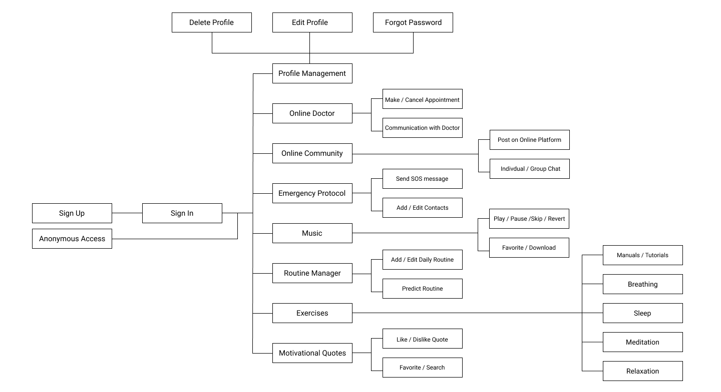
Process Flow Diagram of Proposed Project
Figure-1: Process Flow Diagram – System Interaction For Tranquility.

Slide 12
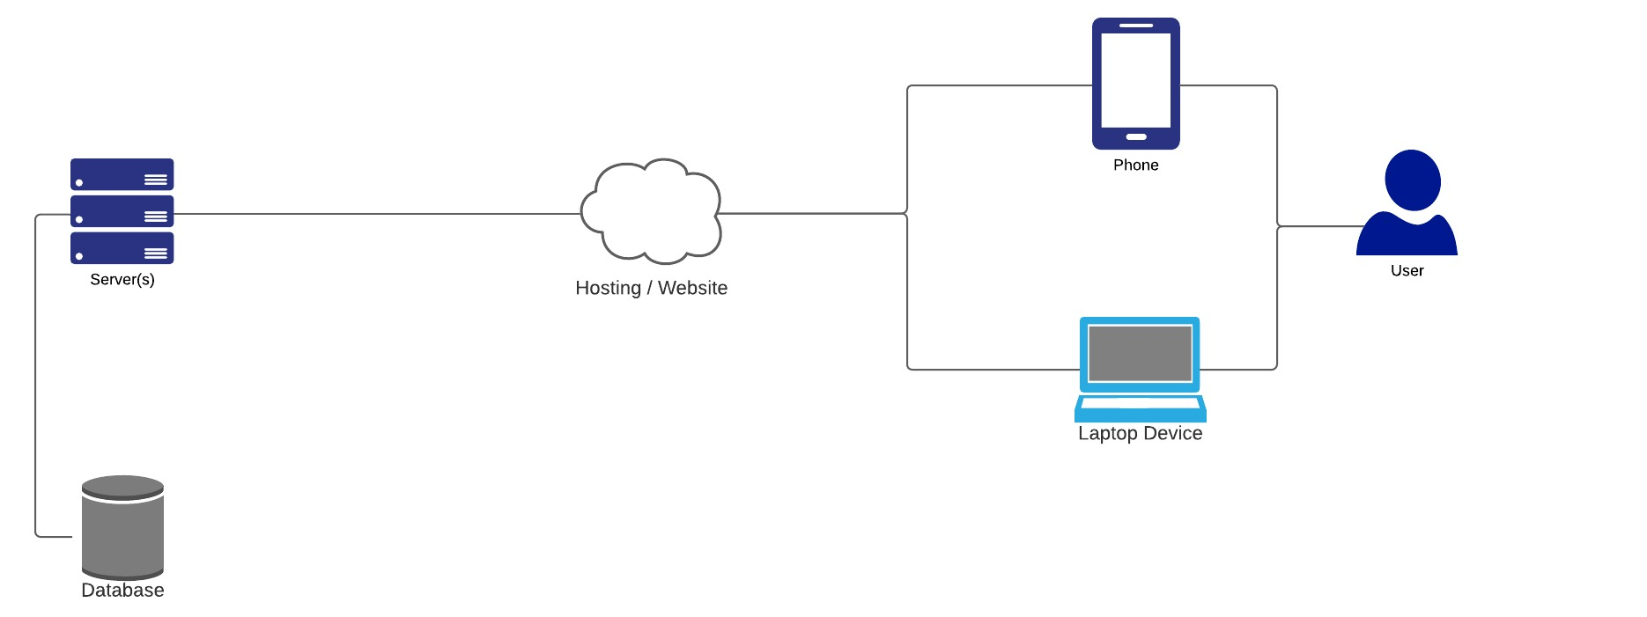
Architecture Diagram of Proposed Project
Figure-2: Client-Server Architecture Diagram

Slide 13
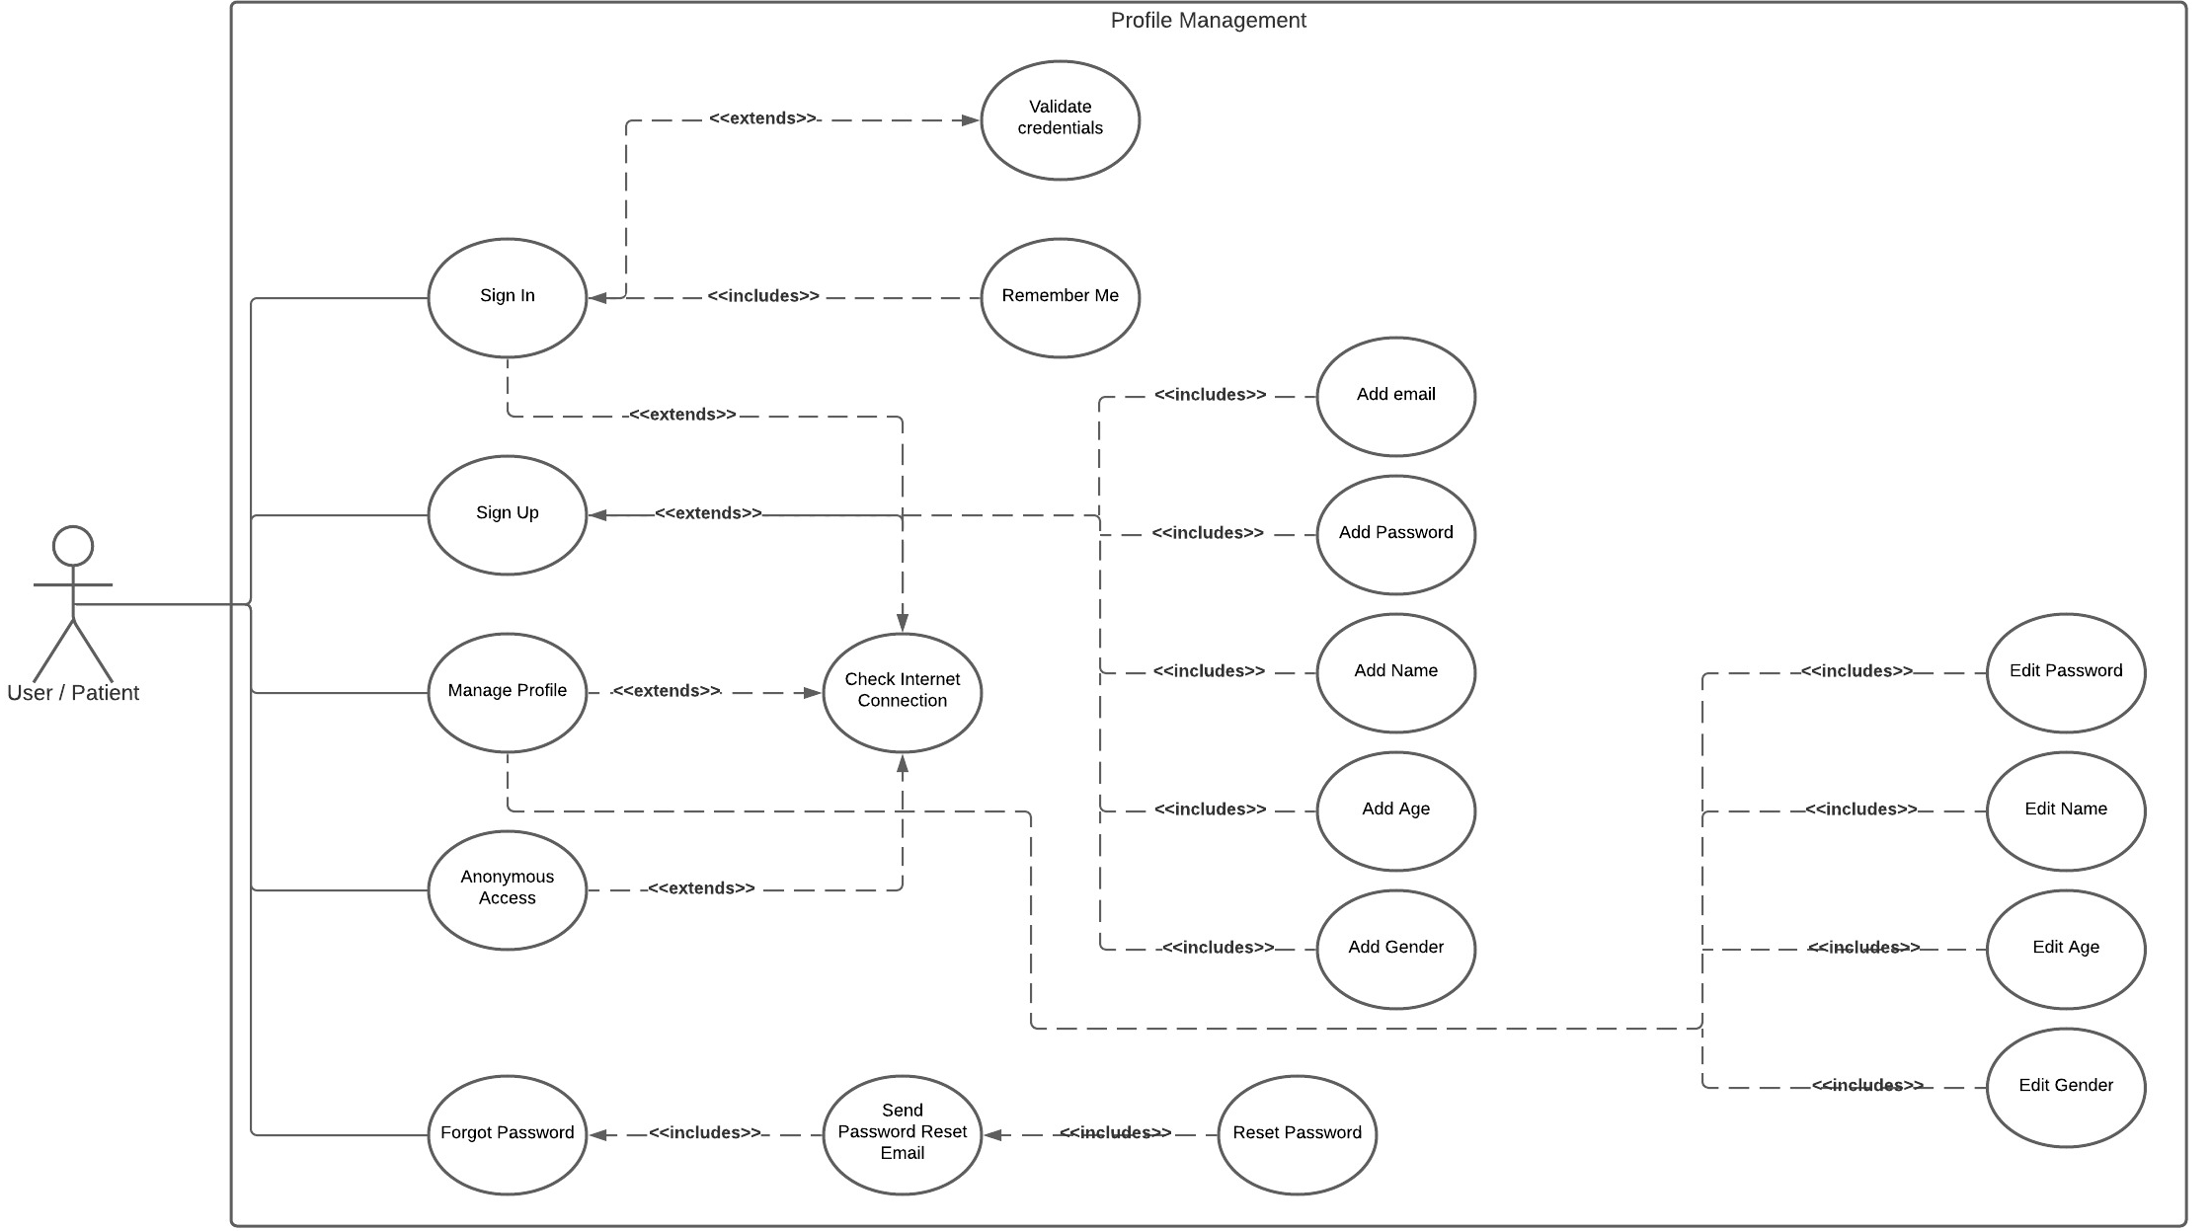
UC Diagram of Profile Management

Slide 14
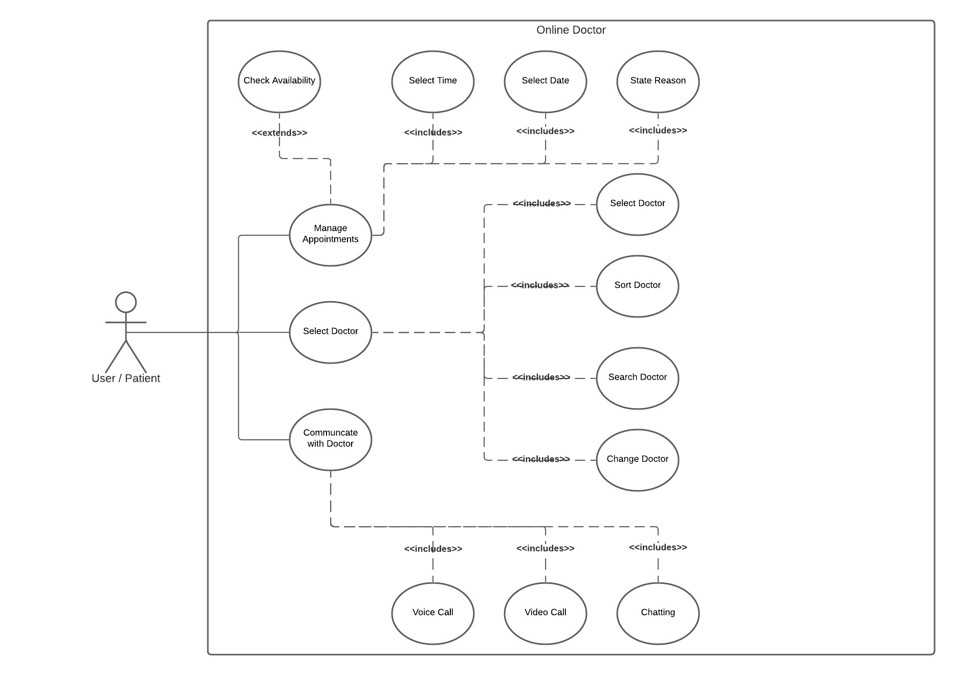
UC Diagram of Online Doctor

Slide 15
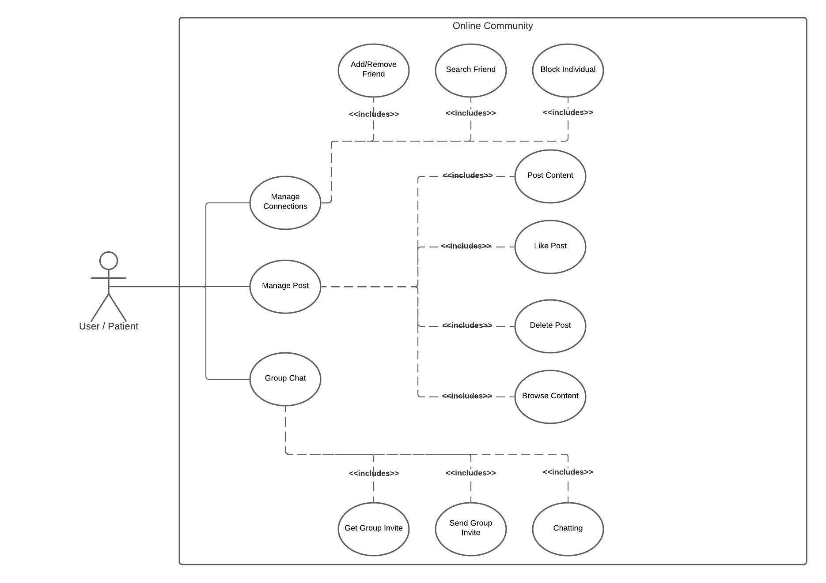
UC Diagram of Online Community

Slide 16
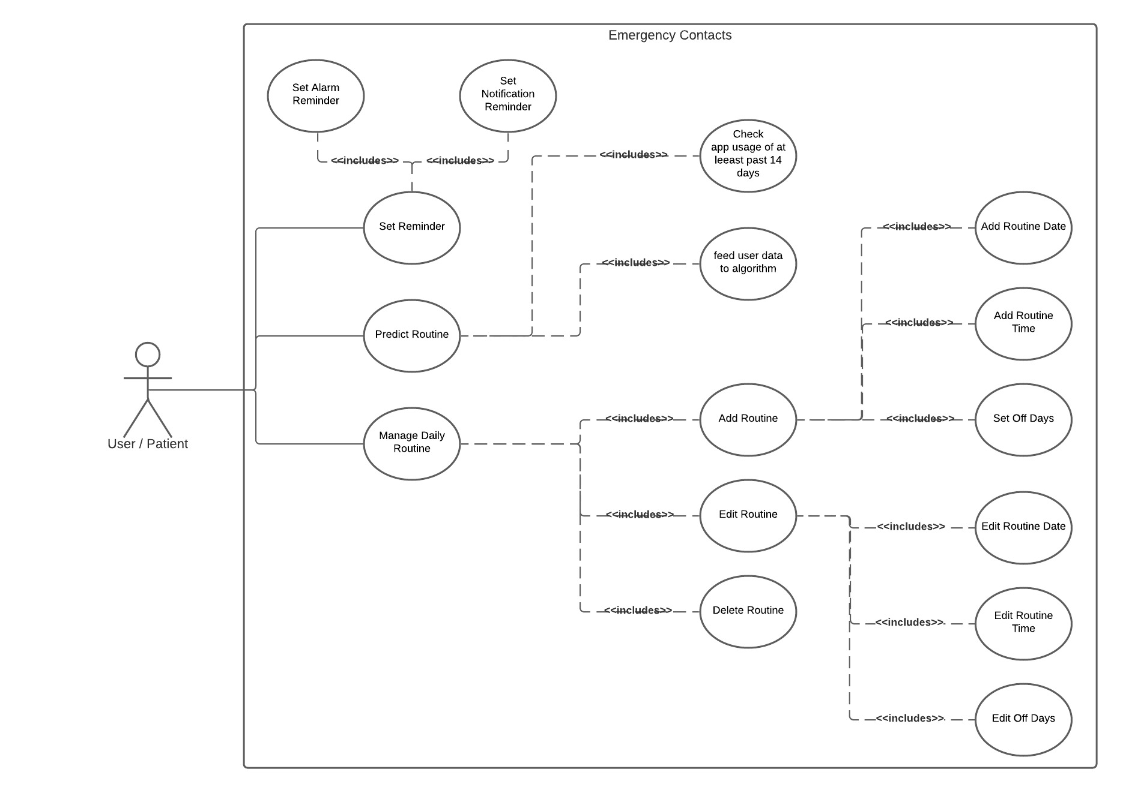
UC Diagram of Emergency Protocol

Slide 17

UC Diagram of Routine Manager

Slide 18
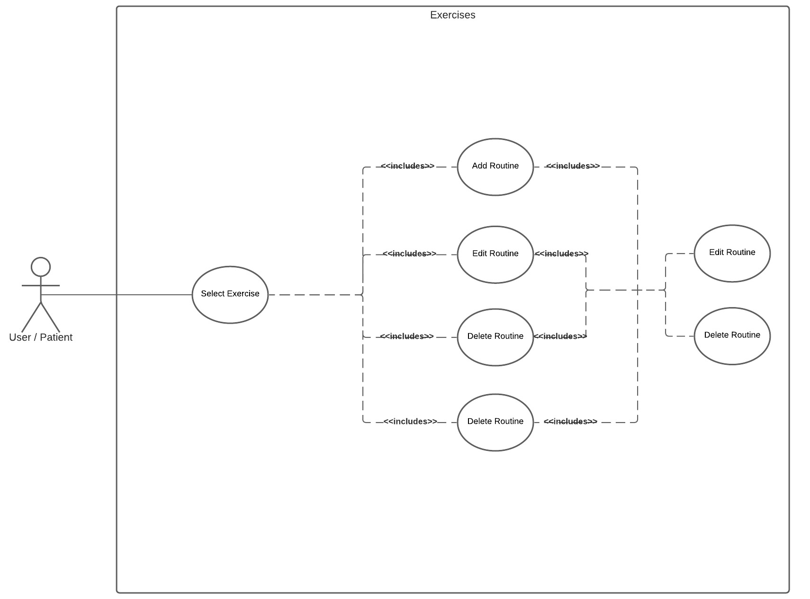
UC Diagram of Exercises

Slide 19
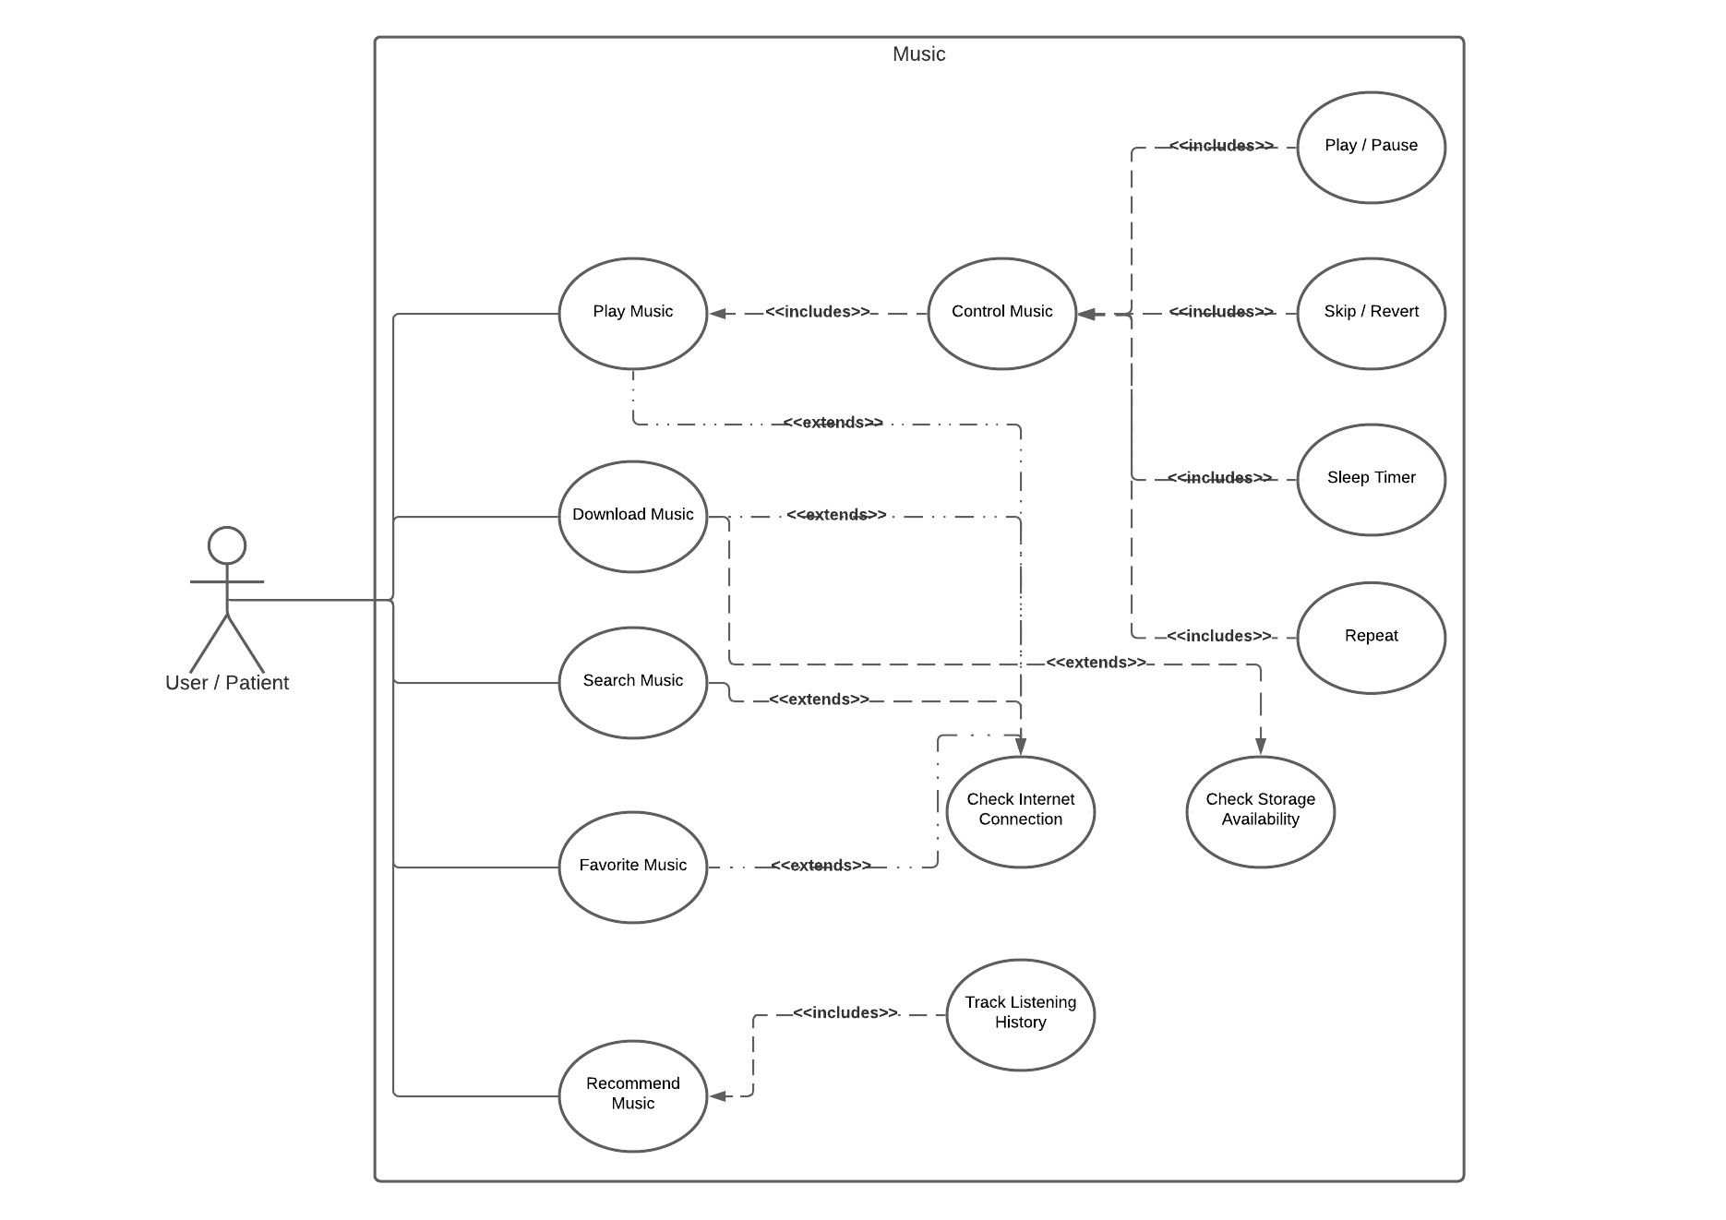
UC Diagram of Music

Slide 20
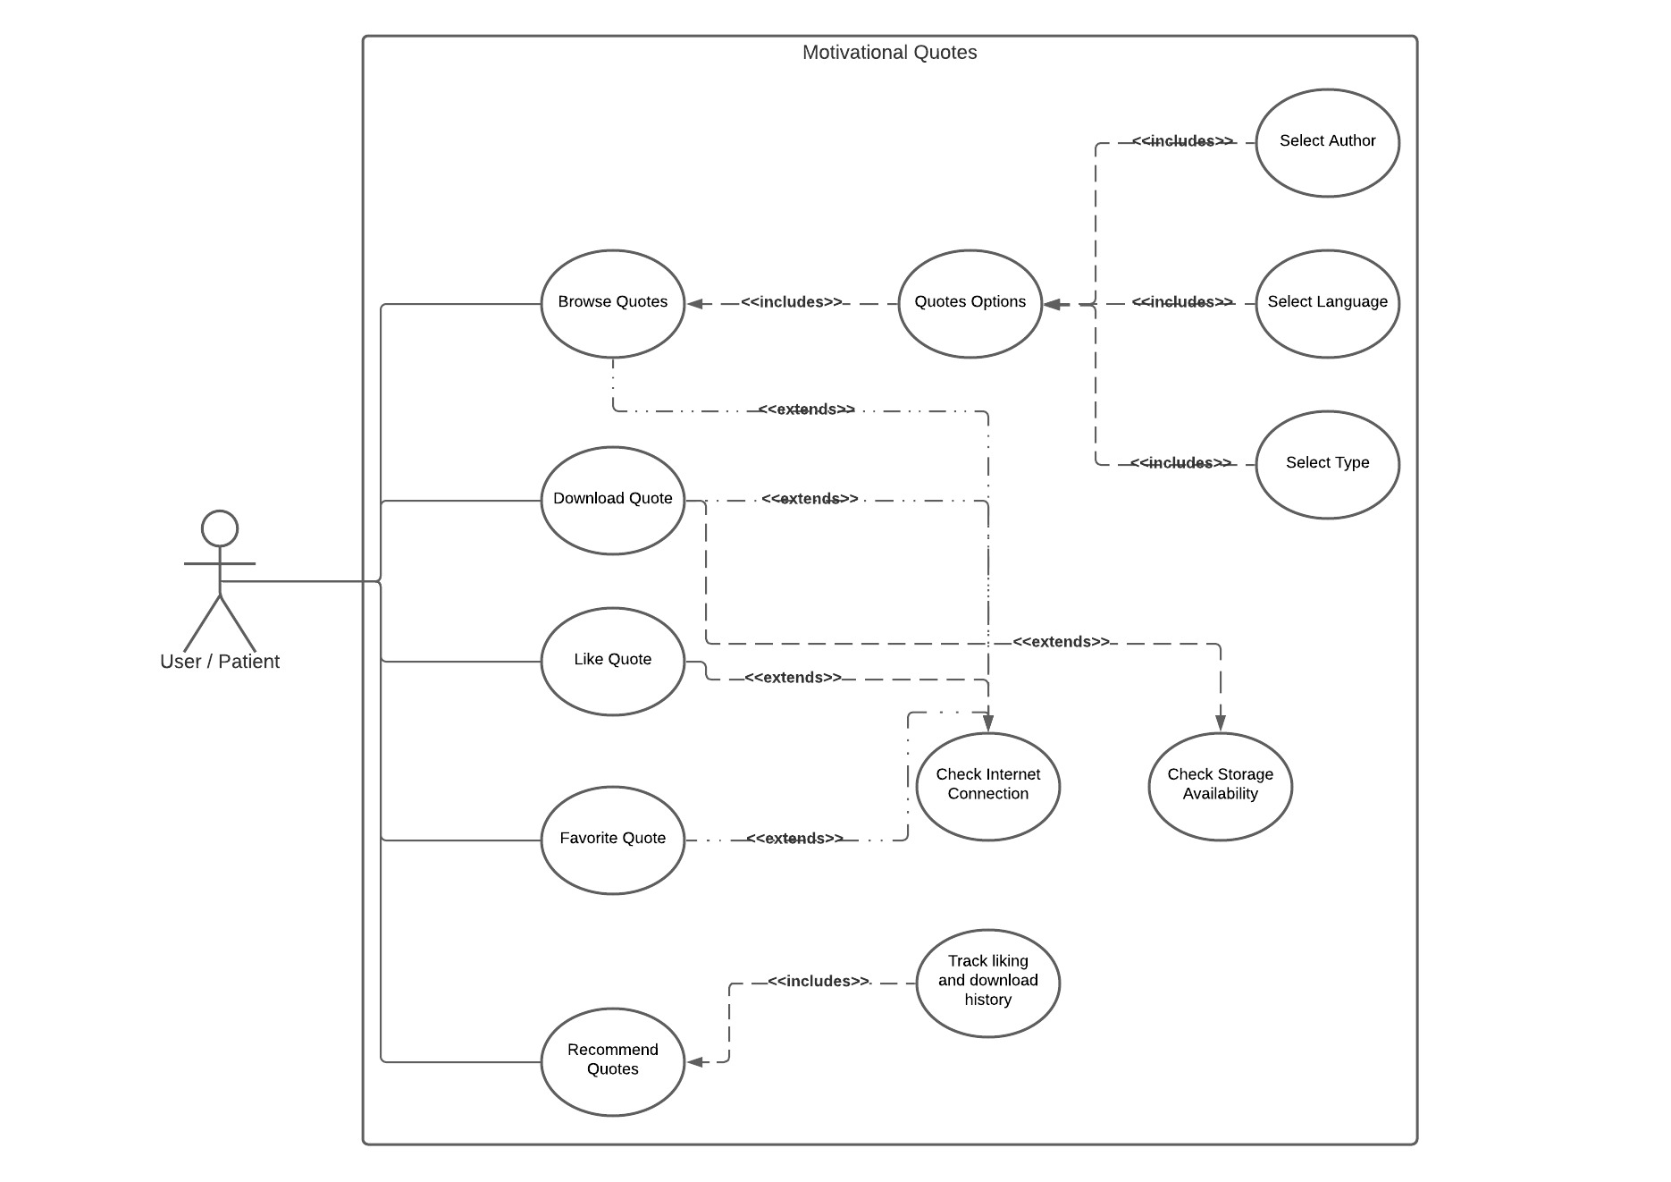
UC Diagram of Motivational Quotes

Slide 21
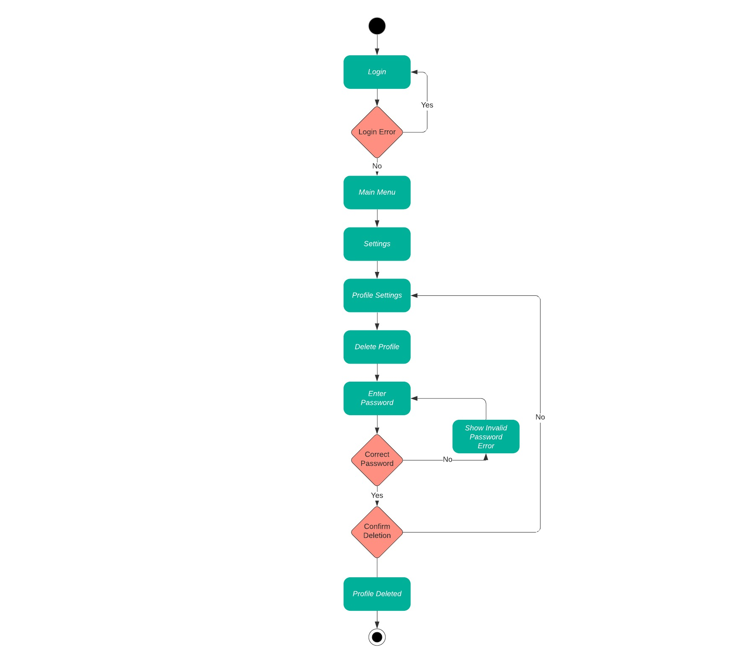
Activity Diagrams
Activity Diagram 1: Delete Profile Activity

Slide 22
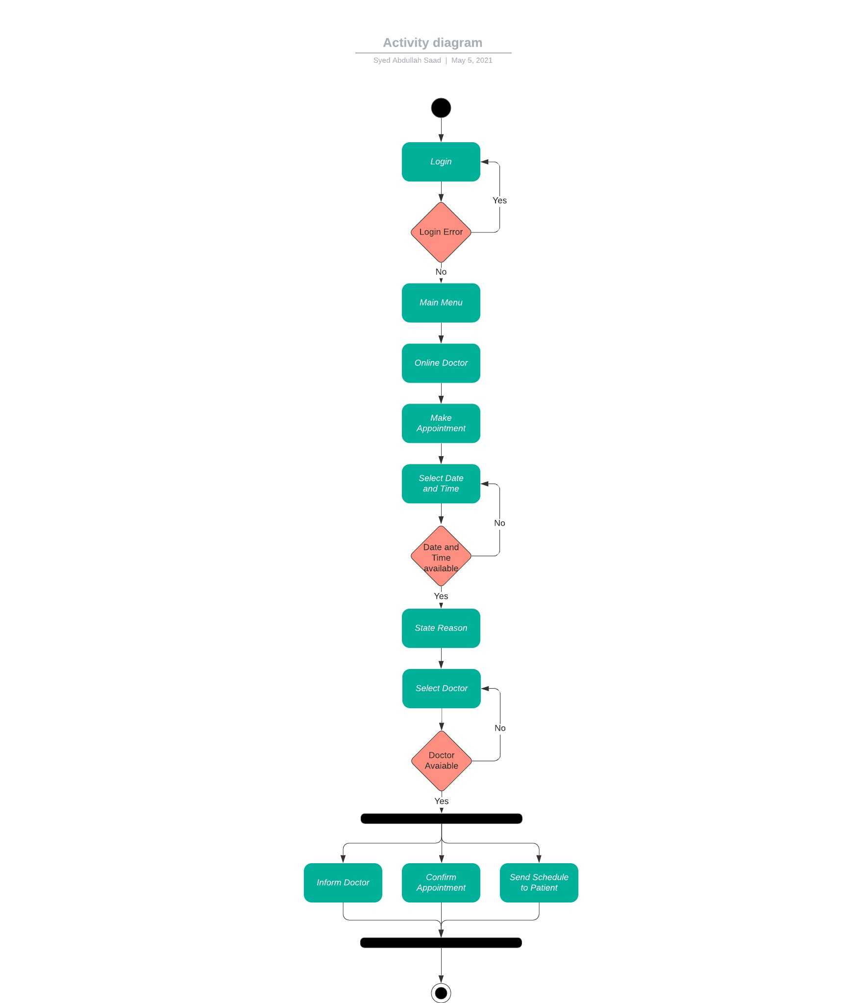
Activity Diagrams
Activity Diagram 2: Set Appointment Activity

Slide 23
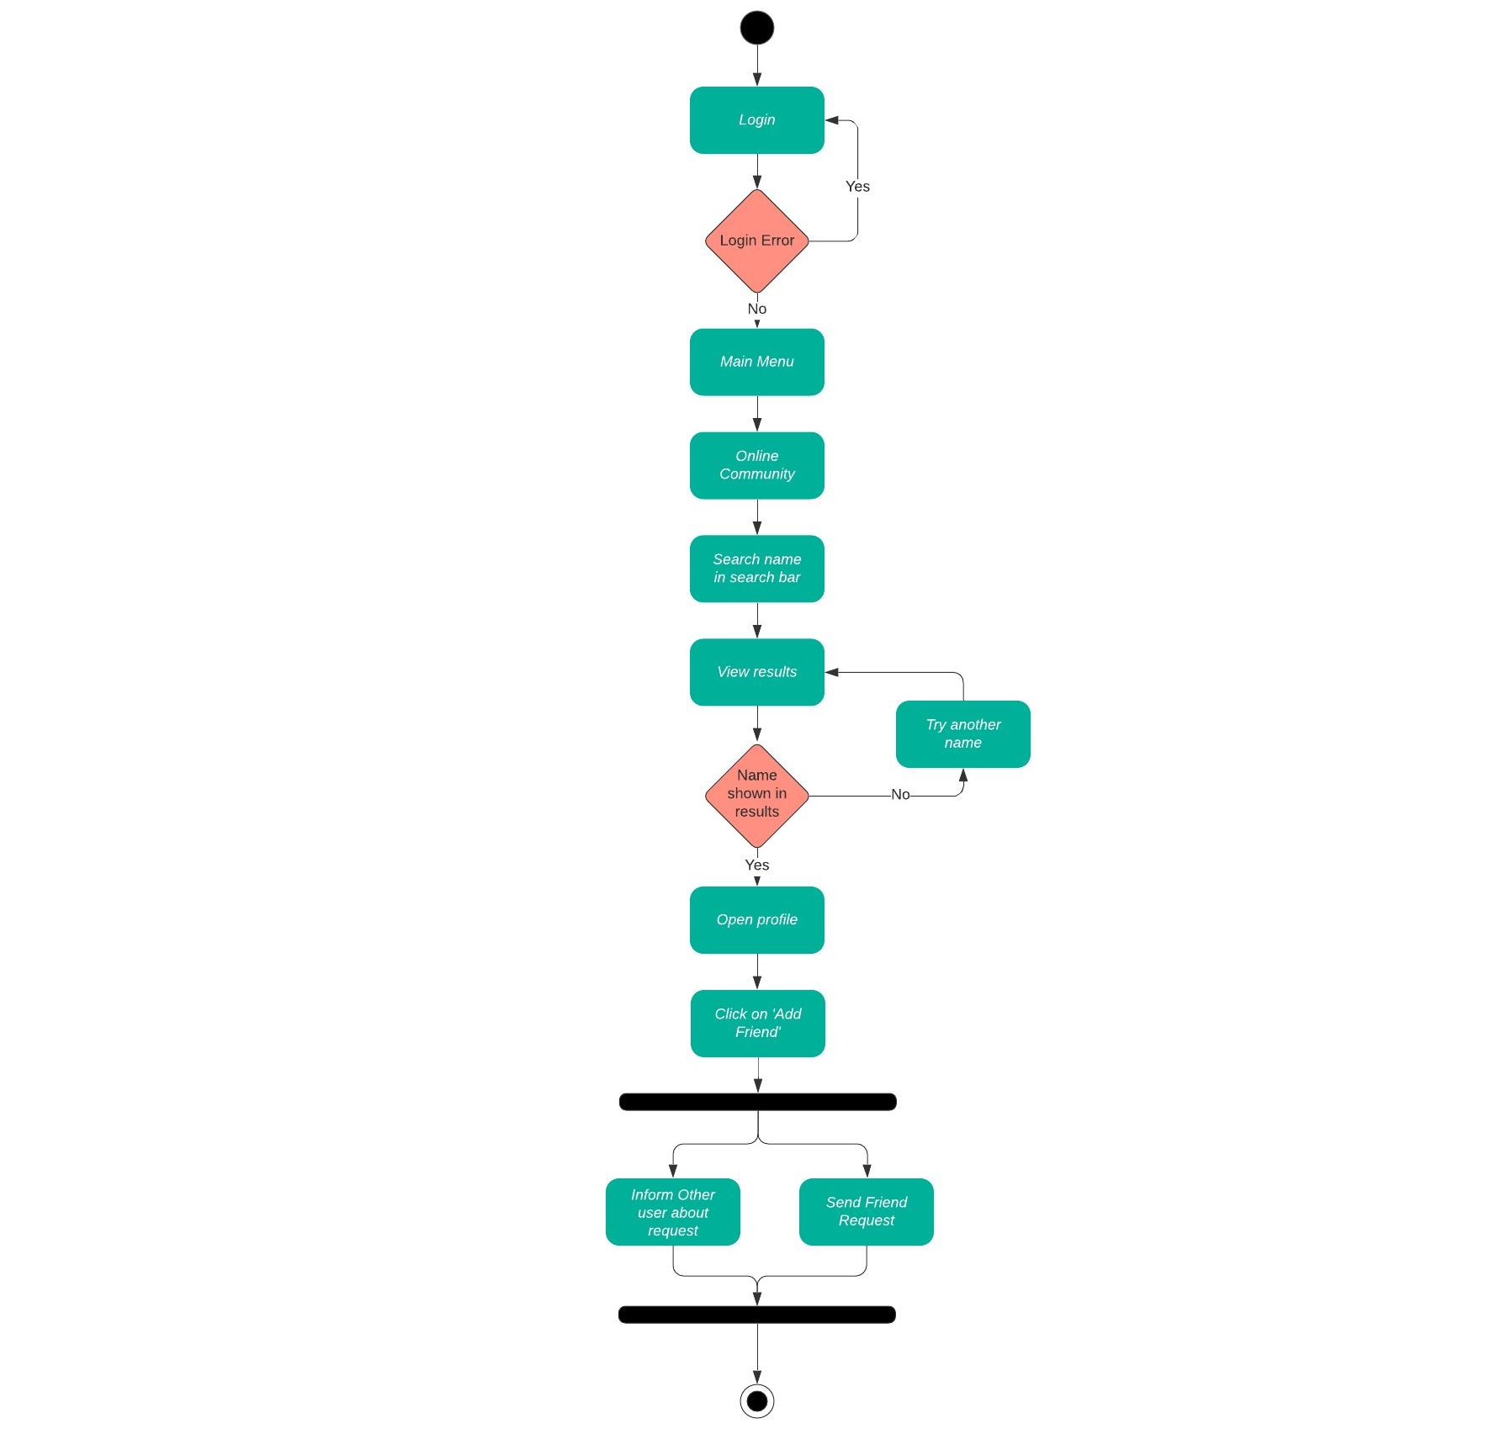
Activity Diagrams
Activity Diagram 3: Add Friend Activity

Slide 24
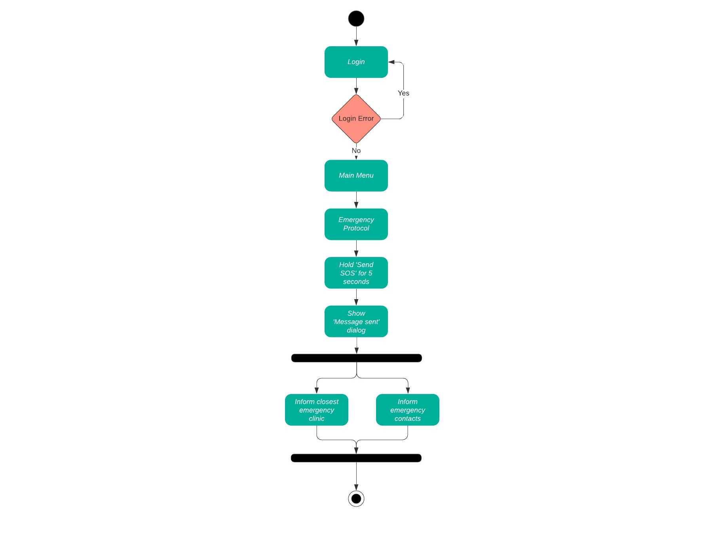
Activity Diagrams
Activity Diagram 4: Send SOS Message Activity

Slide 25
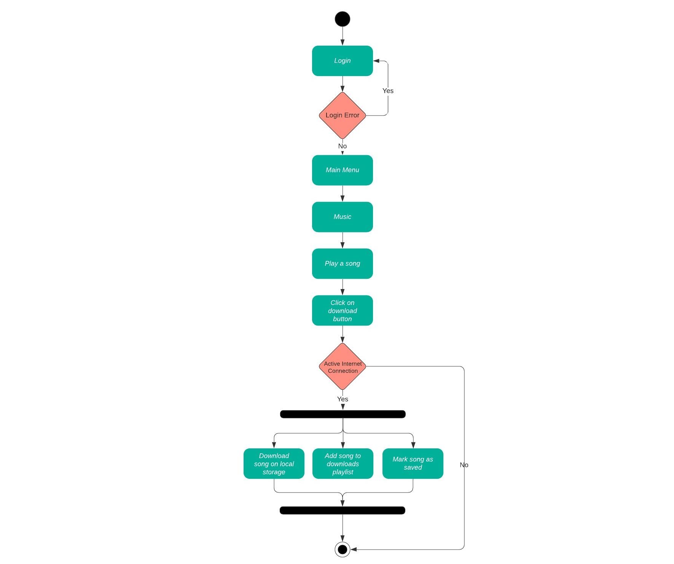
Activity Diagrams
Activity Diagram 5: Download Song Activity

Slide 26
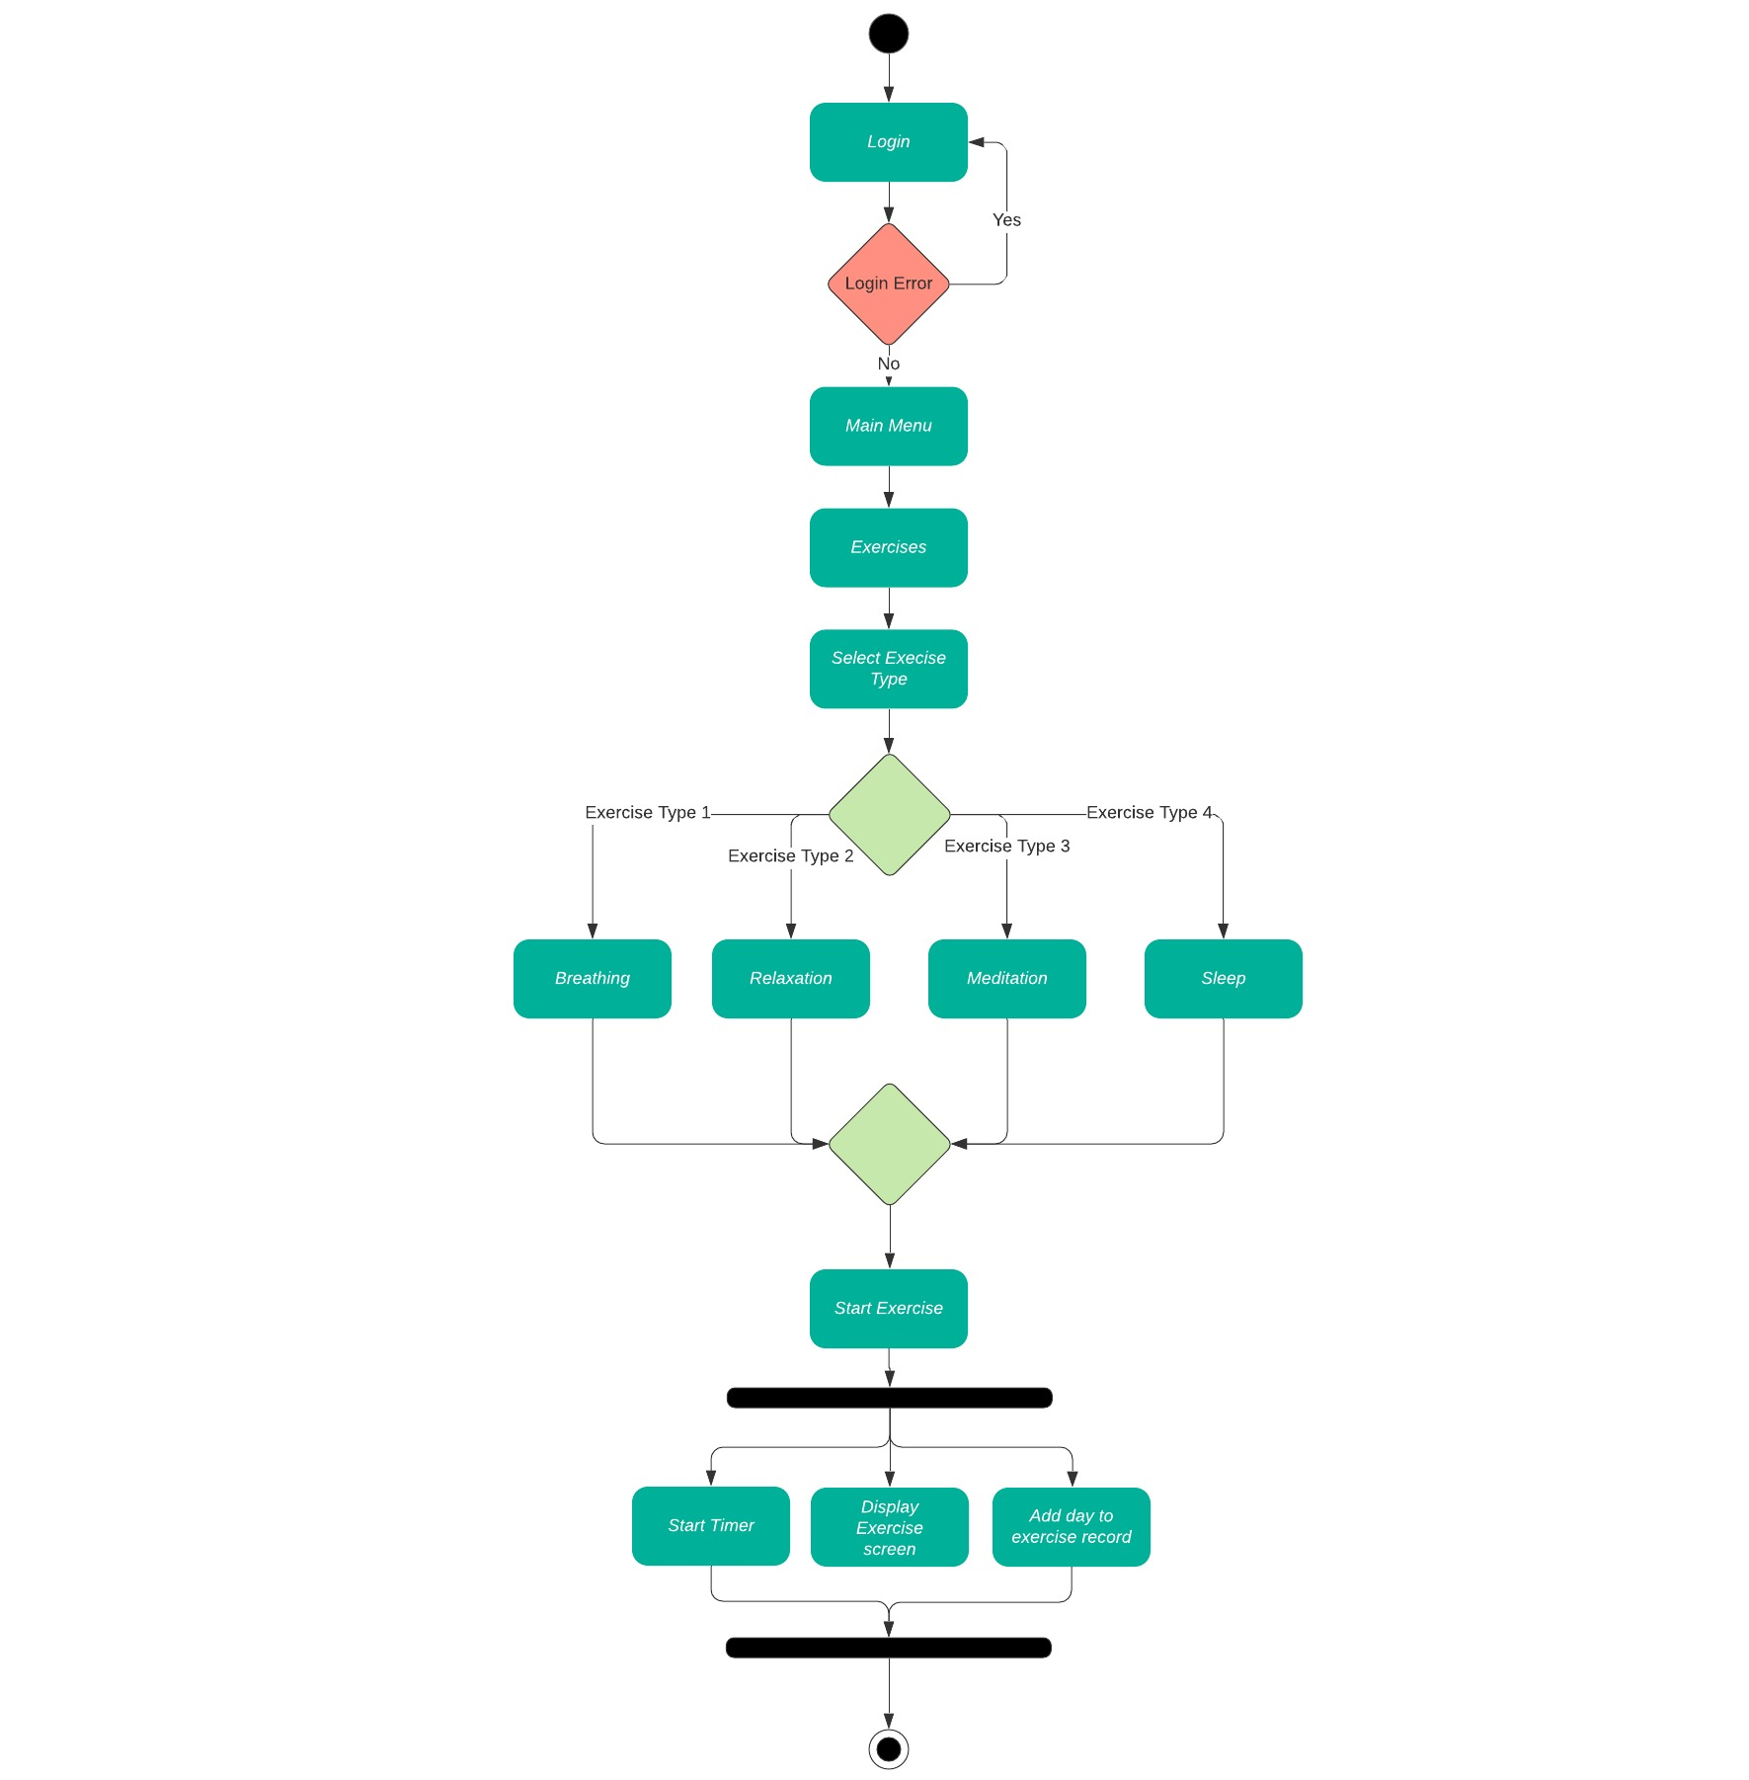
Activity Diagrams
Activity Diagram 6: Exercise Activity

Slide 27
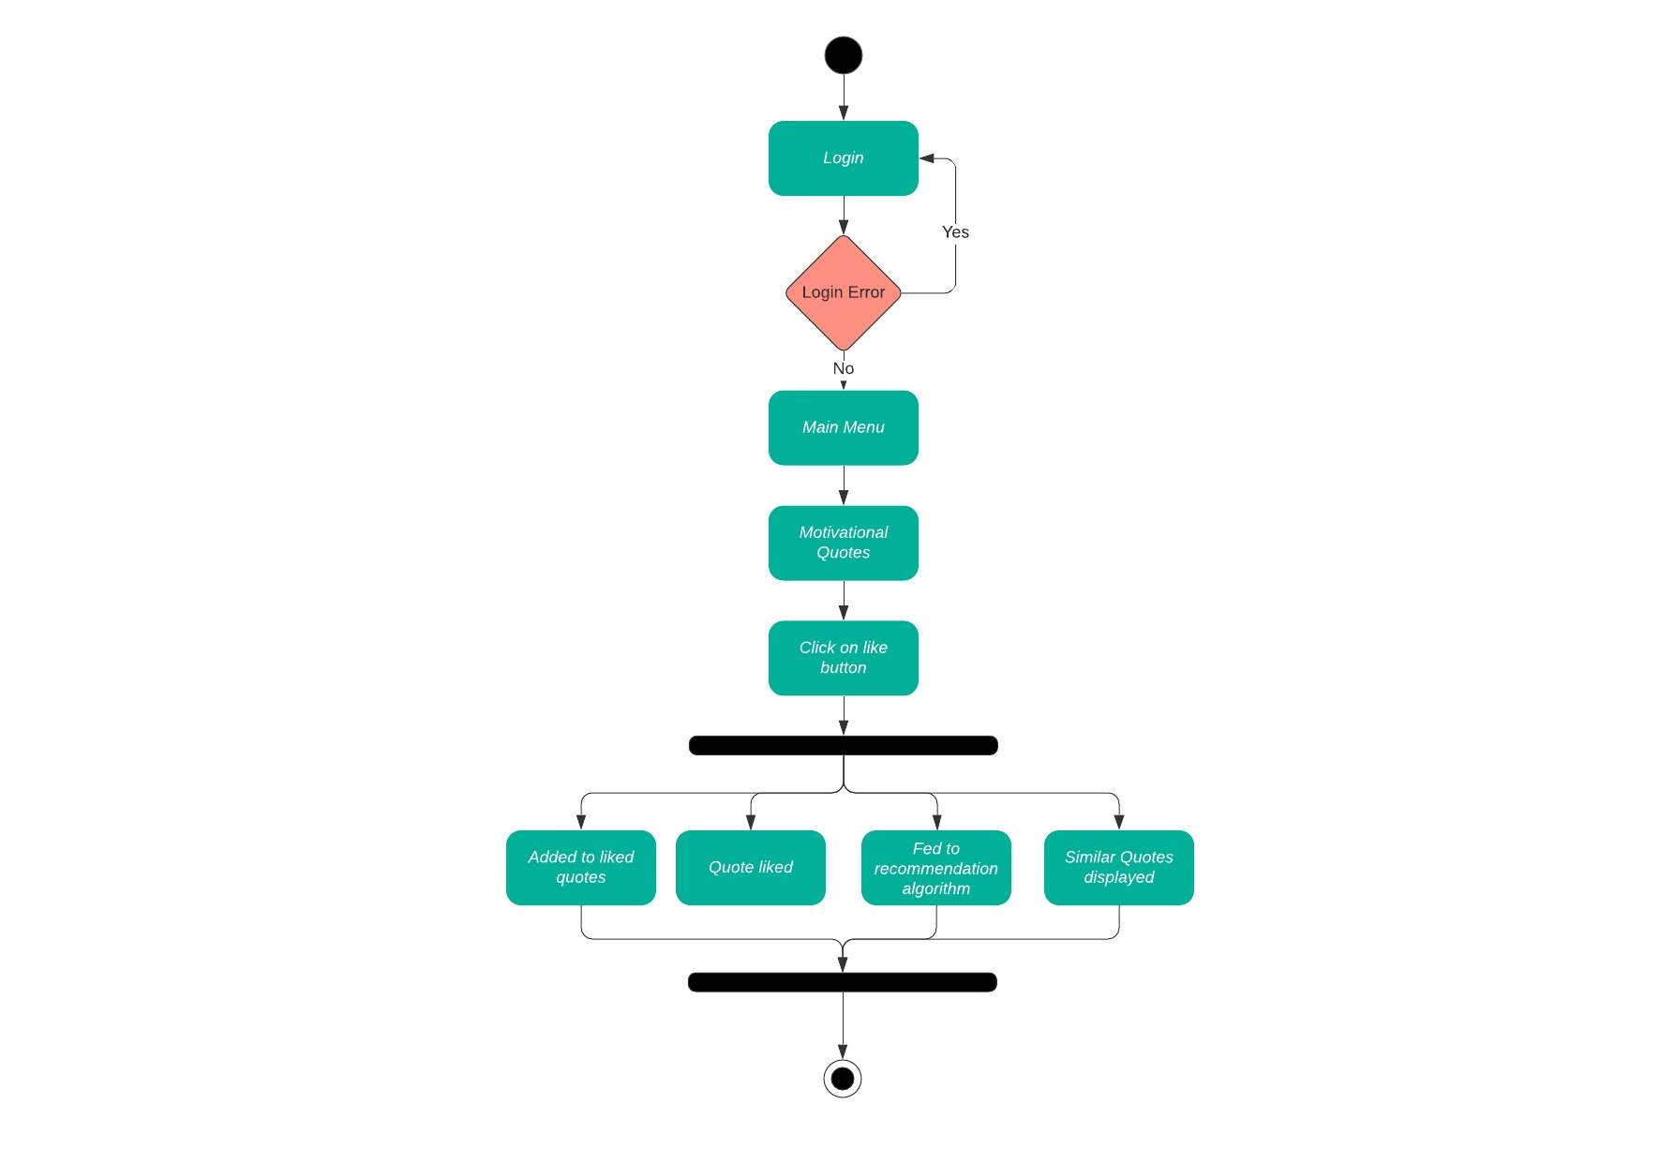
Activity Diagrams
Activity Diagram 7: Like Quote Activity

Slide 28
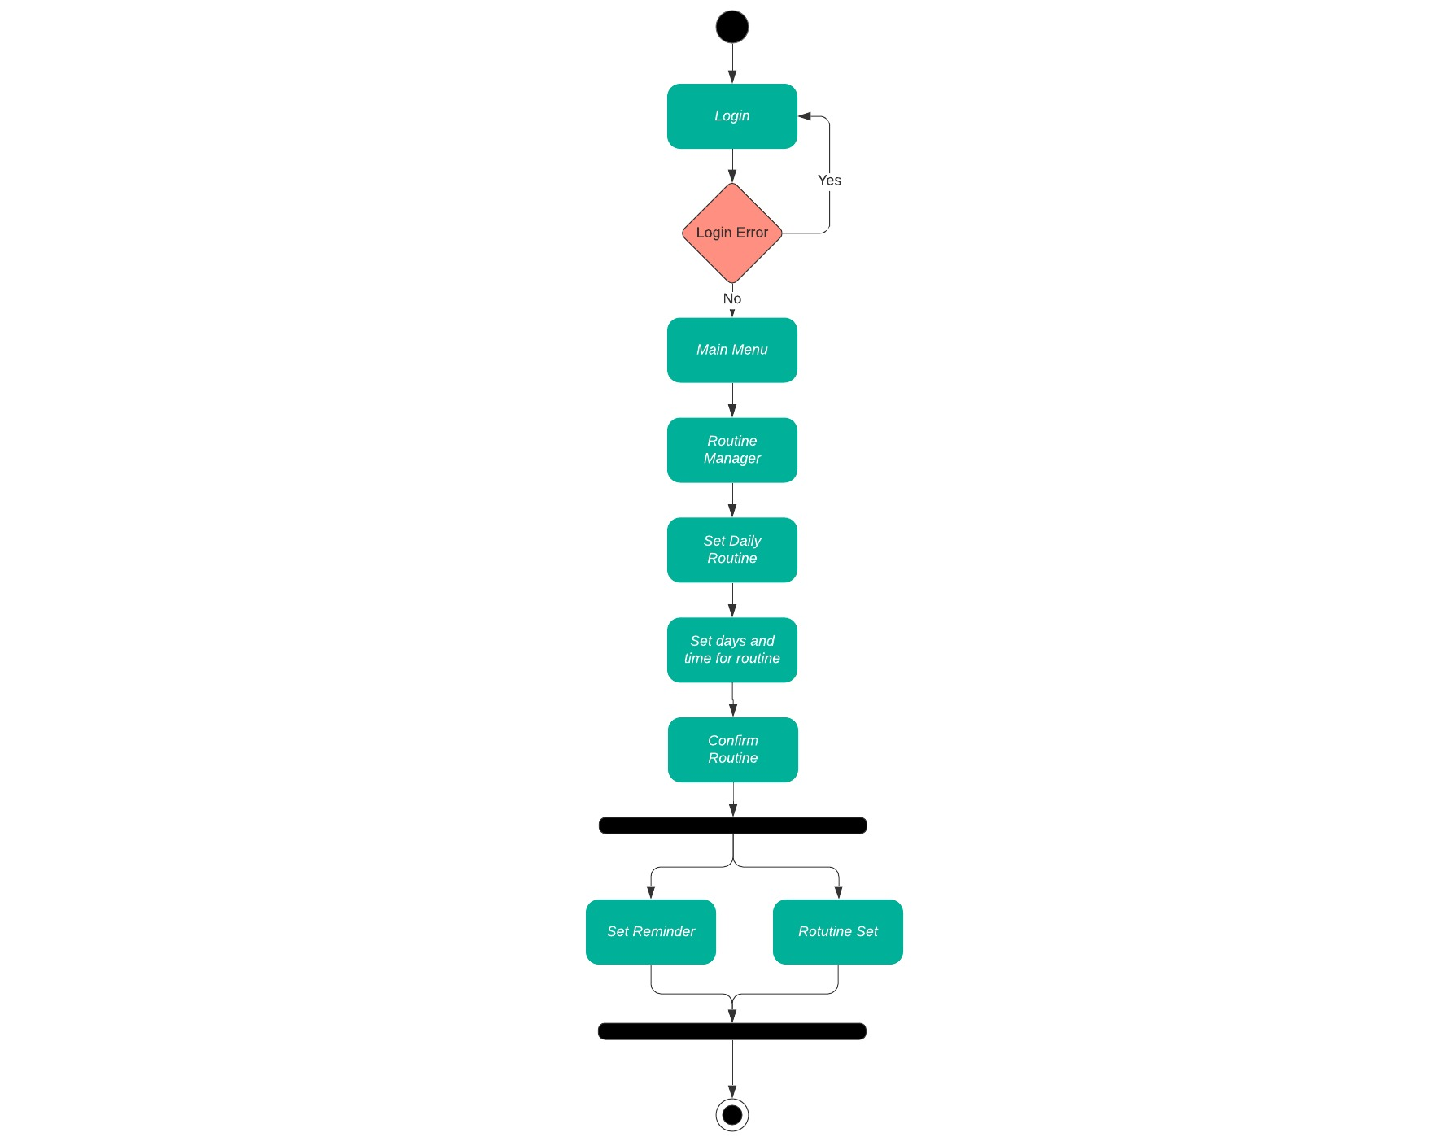
Activity Diagrams
Activity Diagram 8: Set Routine Activity

Slide 29
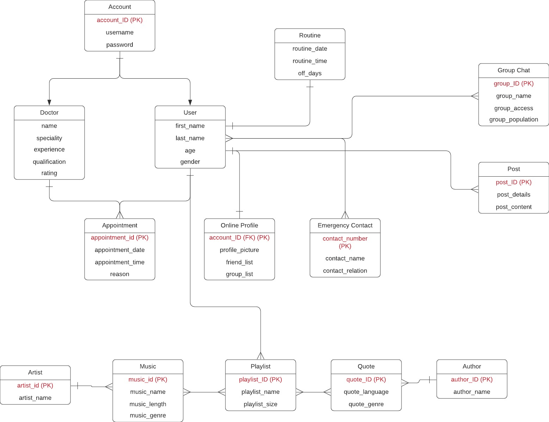
Data Representation [ERD, XML schema,JSON Schema ]
ERD Diagram for Tranquility

Slide 30
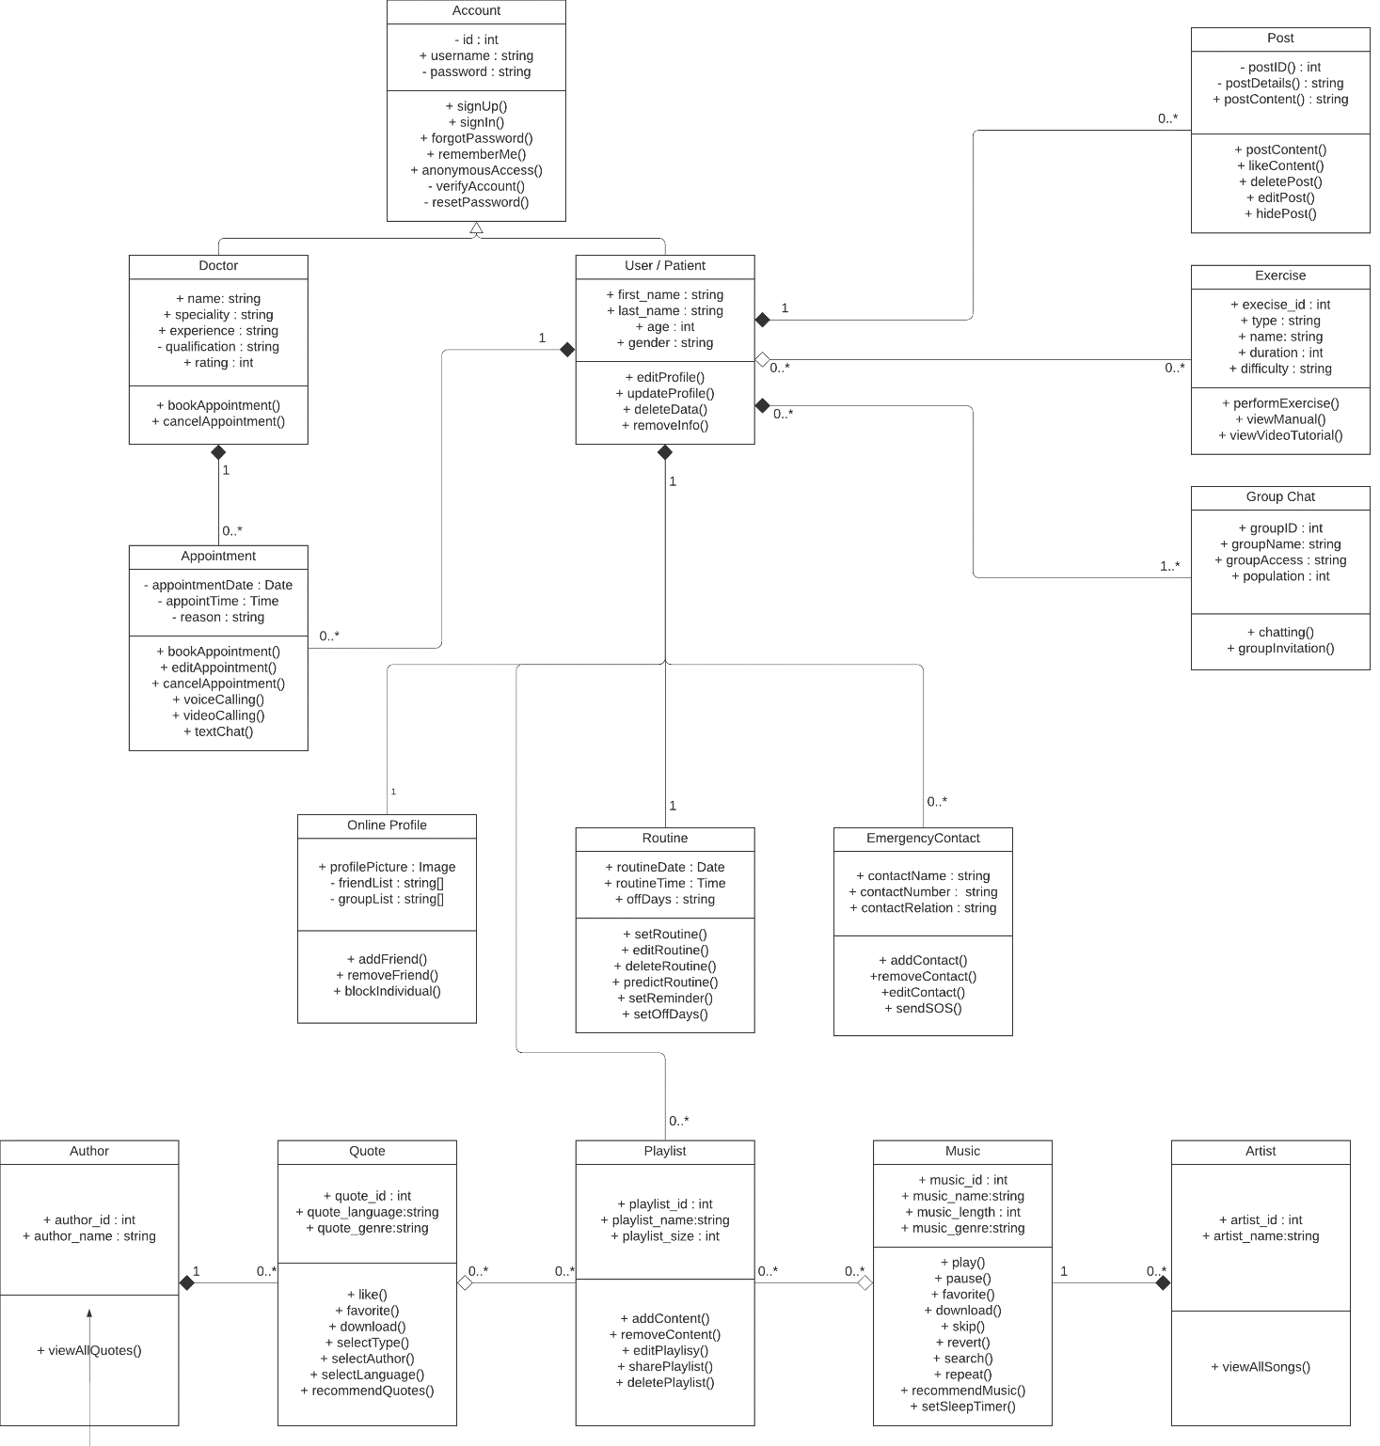
Class Diagram or Data Flow Diagrams
Class Diagram for Tranquility

Slide 31
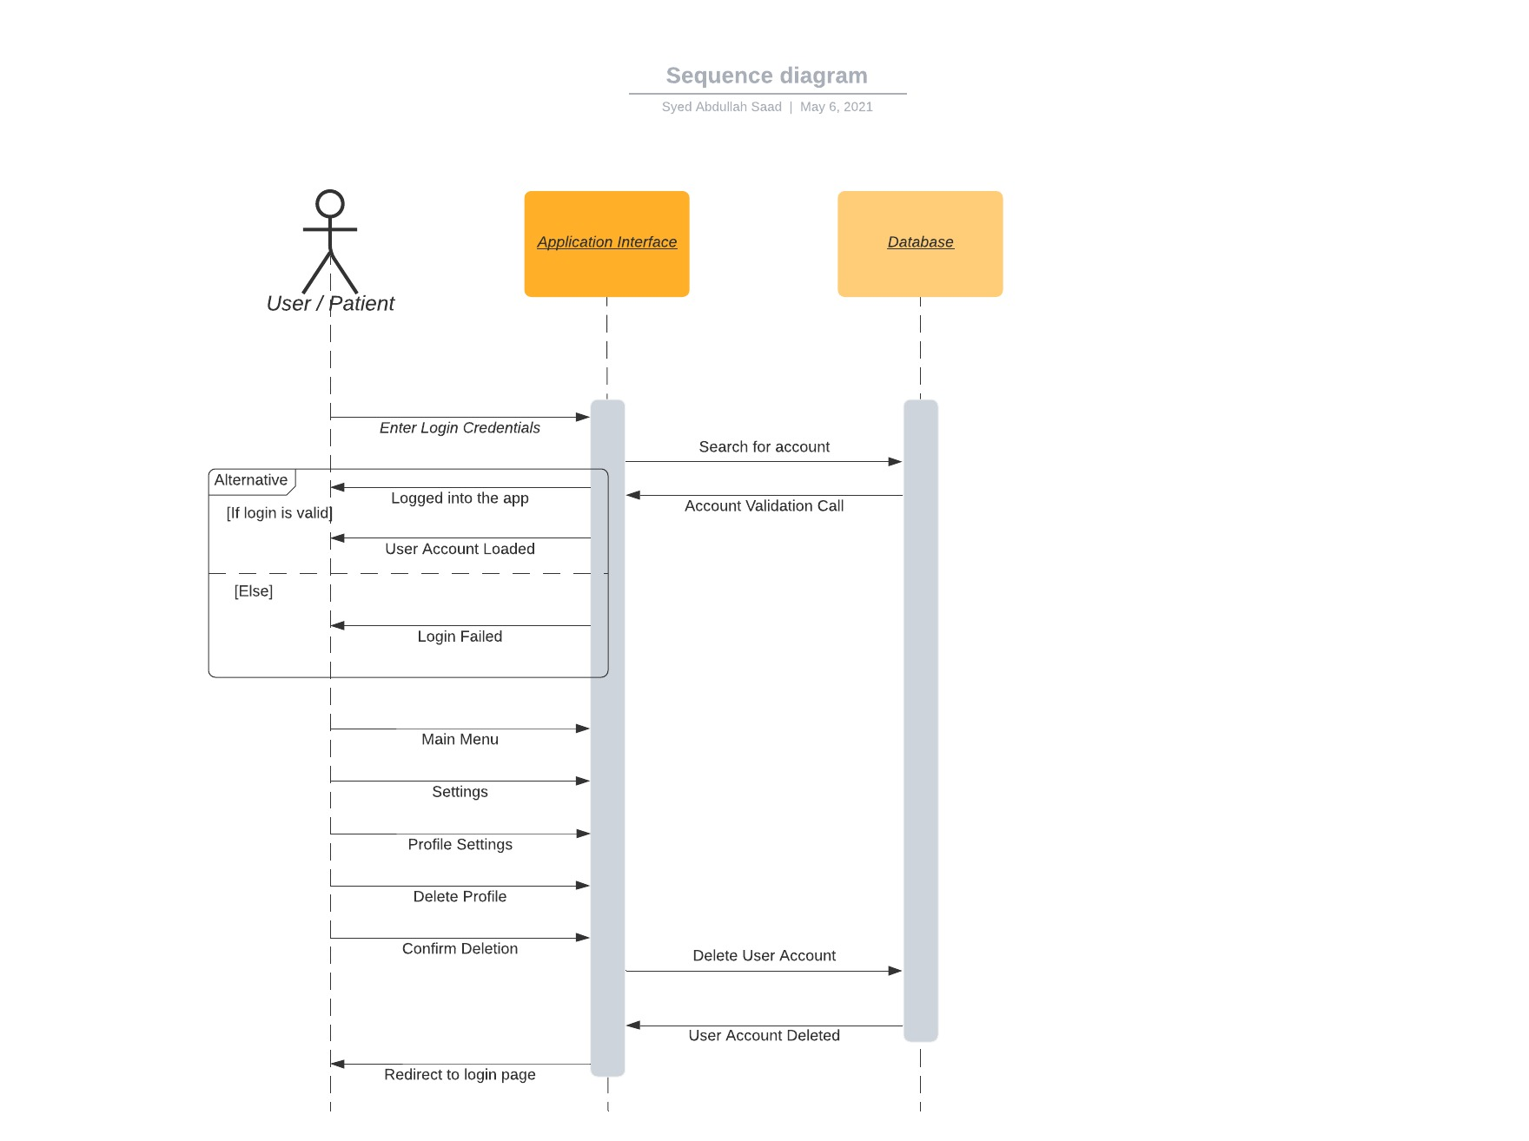
Sequence Diagram
Sequence Diagram 1: Login Sequence

Slide 32
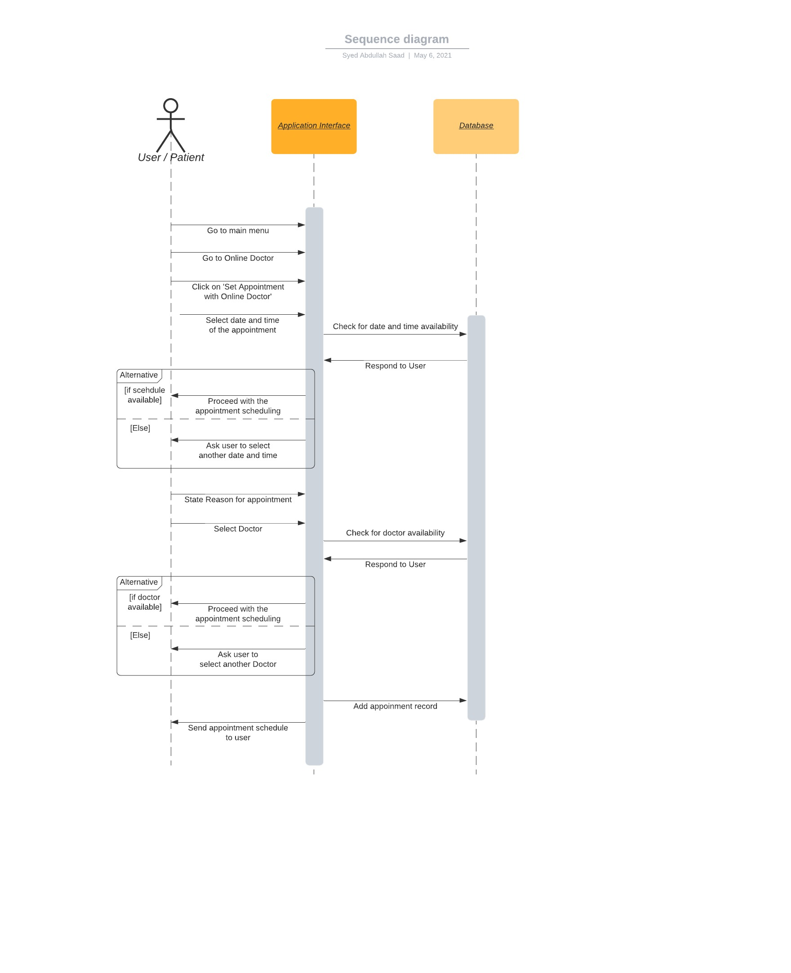
Sequence Diagram
Sequence Diagram 2: Set Appointment Sequence

Slide 33
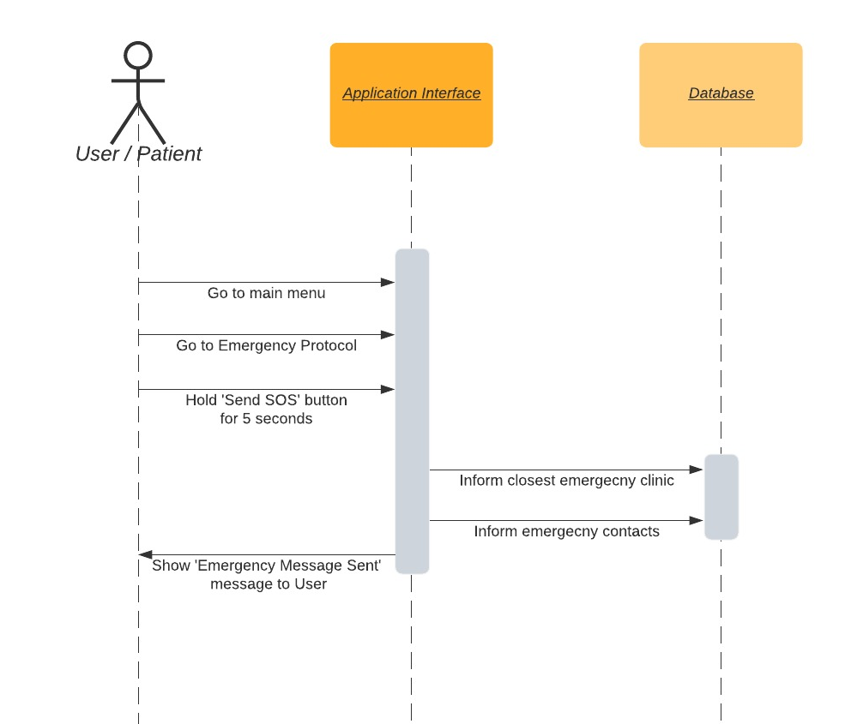
Sequence Diagram
Sequence Diagram 3: Send SOS Message Sequence

Slide 34
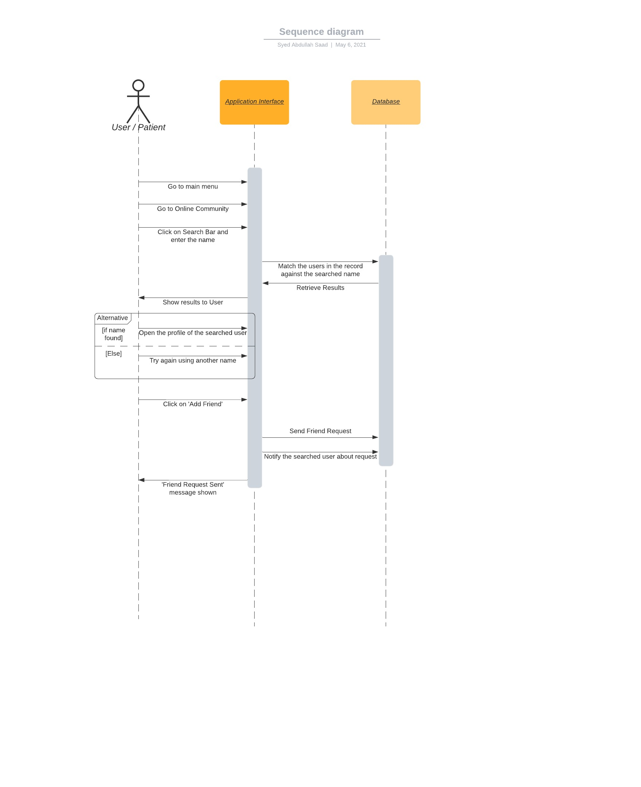
Sequence Diagram
Sequence Diagram 4: Add Friend Sequence

Slide 35
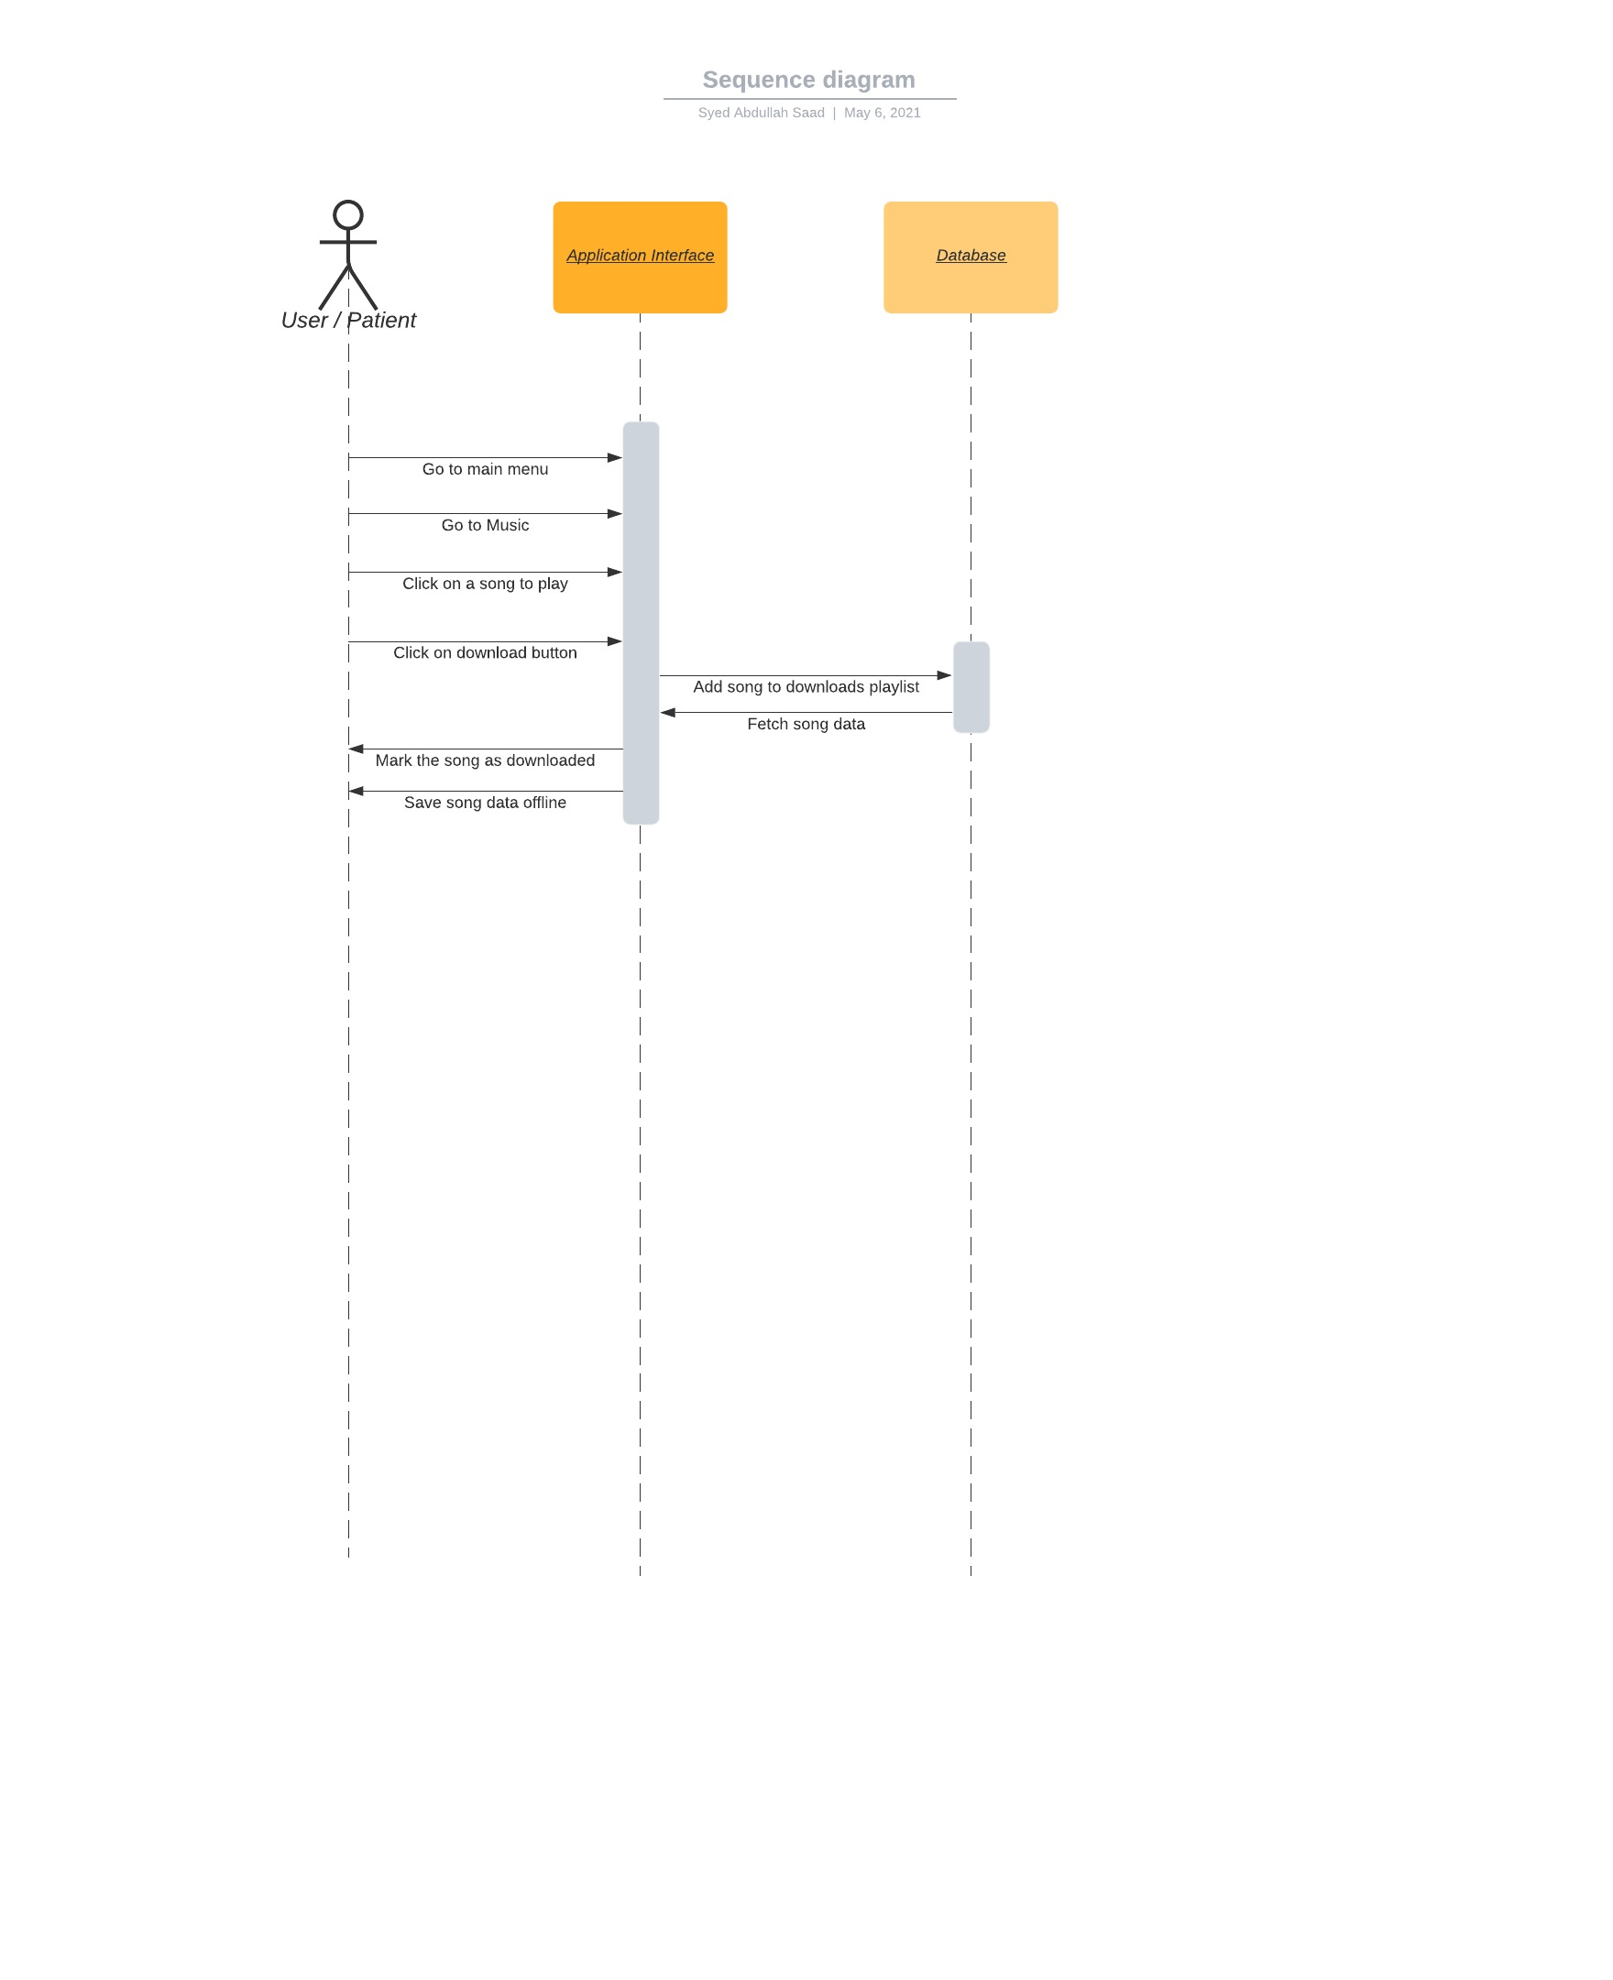
Sequence Diagram
Sequence Diagram 5: Download Song Sequence

Slide 36
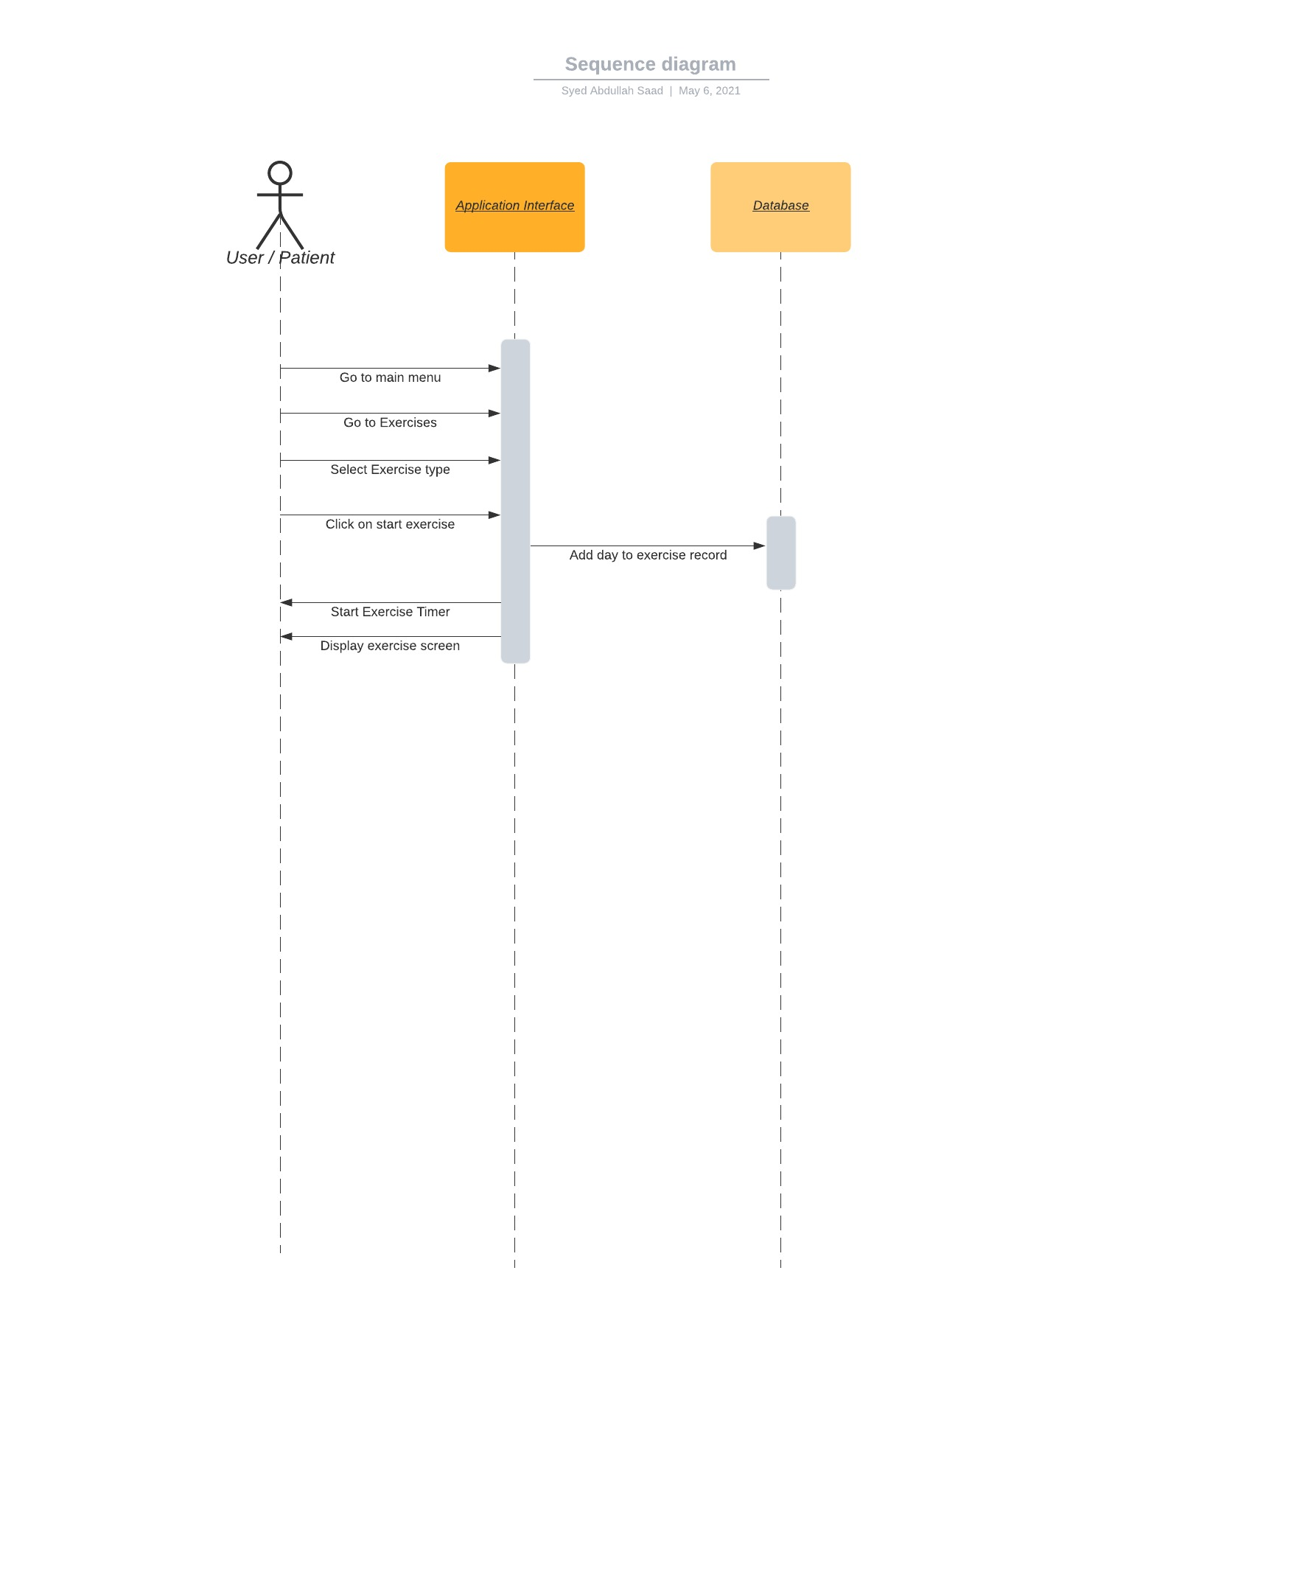
Sequence Diagram
Sequence Diagram 6: Exercise Sequence

Slide 37
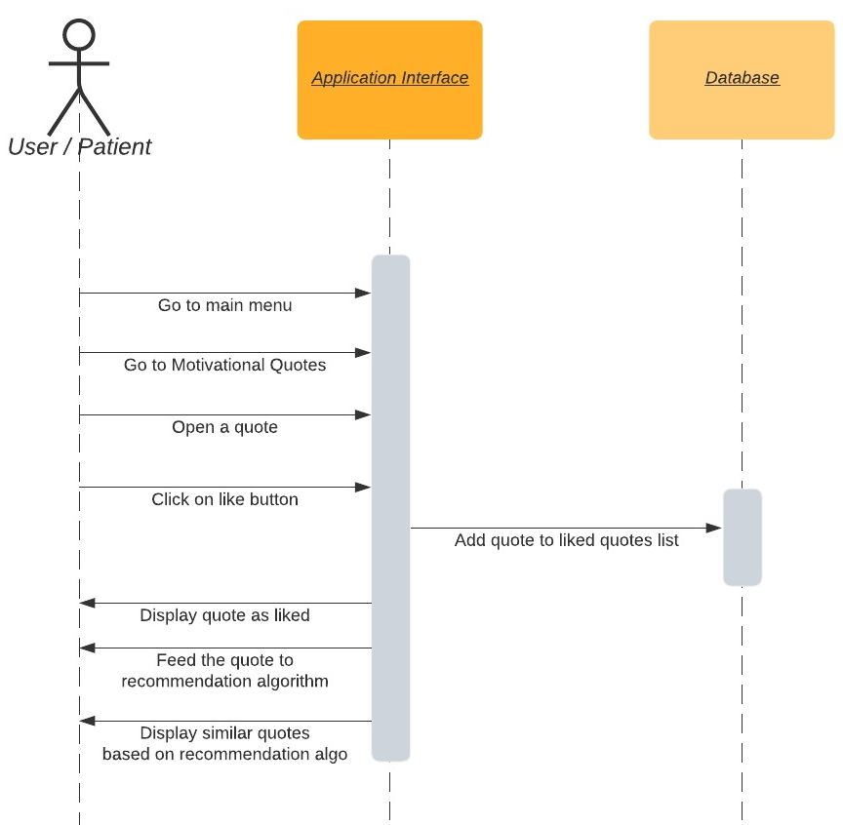
Sequence Diagram
Sequence Diagram 7: Like Quote Sequence

Slide 38
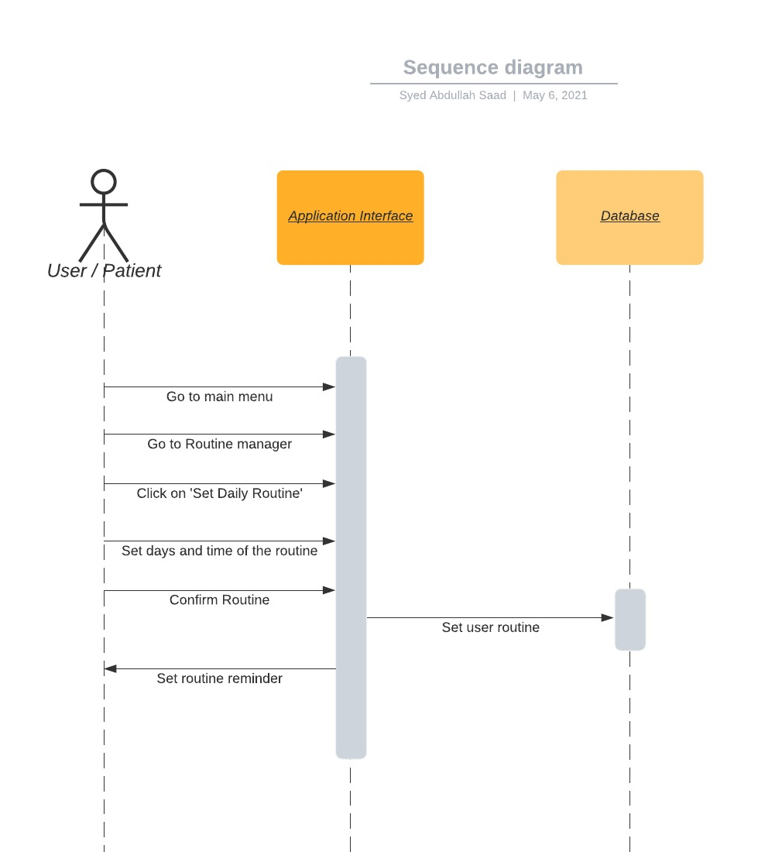
Sequence Diagram
Sequence Diagram 8: Set Daily Routine Sequence

Slide 39
Data Design
Database Relations:
Account(account_id(PK), username, password)
Author(author_ID(PK), author_name)
Appointment(appointment_id(PK), appointment_date, appointment_time, reason)
Artist(artist_id(PK), artist_name)
Doctor(account_id(PK), name, specialty, experience, qualification, rating)
Emergency Contact(contact_number(PK), contact_name, contact_relation)
Group Chat(group_id(PK), group_name, group_access, group_population)
Music(music_id(PK), music_name, music_length, music_genre)
Online Profile(account_ID(PK), profile_picture, friend_list, group_list)
Post(post_ID(PK), post_details, post_content)
Playlist(playlist_id(PK), playlist_name, playlist_size)
Quote(quote_id(PK), quote_language, quote_genre)
Routine(routine_date, routine time, off_days)
User(account_id(PK), first_name, last_name, age, gender)

Slide 40
Algorithm & Implementation
Deep Learning:
Deep Learning technique is used in our application, deep learning is generally known as a subfield of machine learning which is inspired by the algorithms which are inspired and structured by keeping in view the functionality of human brain. In deep learning, the system trains itself by keeping in view the same pattern as a human brain follows, in liking or hating something. Deep learning is now a days a very vast field and the entire future is based on it.

Slide 41
Algorithm & Implementation
Deep Learning in Music:
In Music section, the application recommends the user with the music which he/she likes. Our system uses the BART (Bandits for recommendations as treatments) algorithm. By using this, the system analysis the previous raw data of the user and runs the algorithm. The user is recommended with the songs of his/her taste as it keeps the record of the most listened artist as well as the most songs listened of a genre. It works in such a way it tries to avoid recommendations of such songs which are being skipped by the user in the past. If the user listens to a song more than 30 seconds, then the songs of that type are put on a higher priority of recommendation. The system always tries to recommend all the unlisten songs or the new ones. So, that the recommendation can be made according to the user taste.

Slide 42
Algorithm & Implementation
Deep Learning in Quotes:
In Motivational Quotes section, the application analyzes the liked quotes and the downloaded ones by the user. The system uses the deep learning algorithm which filters the quotes according to the user taste and then it recommends those quotes to the user in the notification section or in the motivational quotes section in our application.

Slide 43
Algorithm & Implementation
Deep Learning in Routine Management:
In Daily Routine section, our system recommends exercises and sleep time by using deep learning algorithm that works on the daily activity of the user on the application. This algorithm analyses the routine of the user for 14 straight days and after that it uses the neural networks to recommend and predict the sleeping and exercising patterns of the user.

Slide 44
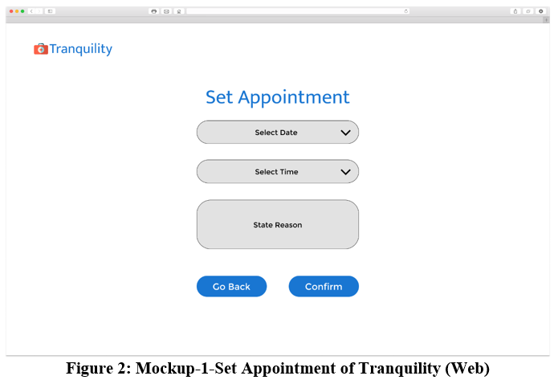
User Interfaces

Slide 45
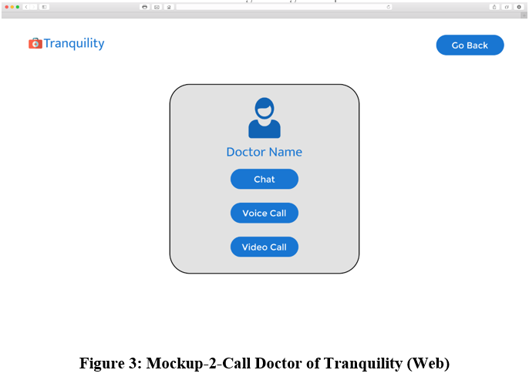
User Interfaces

Slide 46
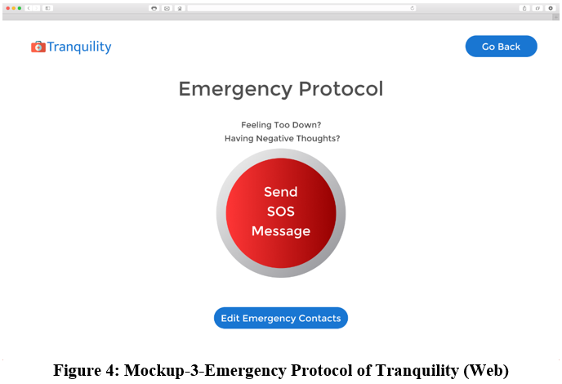
User Interfaces

Slide 47
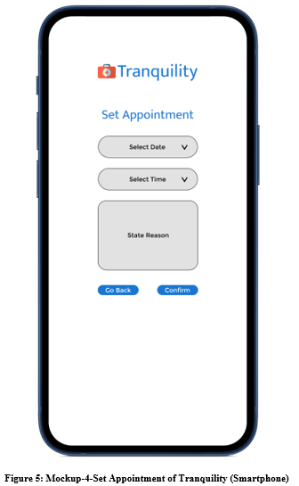
User Interfaces

Slide 48
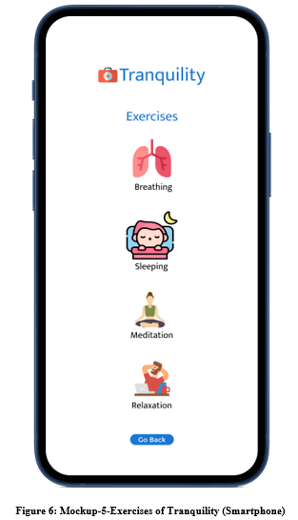
User Interfaces

Slide 49
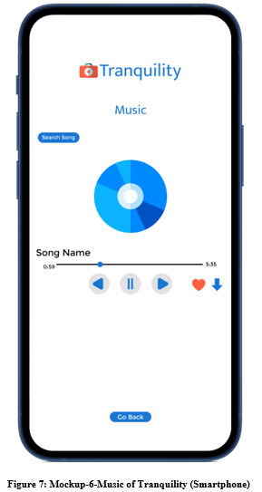
User Interfaces

Slide 50
Conclusion
This document includes all the design work of every aspect of the project. The implementation will be done based on the design described in the document. The OOP programming will be done according to the class diagram provided and the sequence of use cases will be implemented using process flow diagrams. The interaction between the app and the servers will be implemented using sequence diagrams. Thus, the document provides the complete design and structure of the project to be implemented.

Slide 51
References
None.

Slide 52
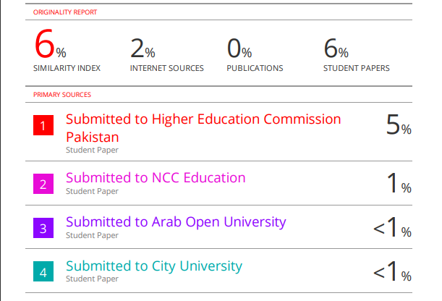
Plaragism Report

Slide 53

Questions and Answers

